Slide 1




The Foul Factor - Predicting the Probability of Fouling Out in Basketball
Group 7:
Karim, Yujin, Alex
Data Science for Sports
Final Presentation
Notes:
KARIM

Slide 2

Agenda
Intro/Context
Methods
Basketball Intro: What is Fouling Out and Why is it an Issue
Setup & Significance
Data
Results
Data Description, Relevance and Limitations
Data Visualization Analysis
Exploratory Analysis
Conclusion
Stakeholder Recommendations
Preliminary Visualizations
Notes:
KARIM

Slide 3
Intro/Context
Notes:
KARIM

Slide 4
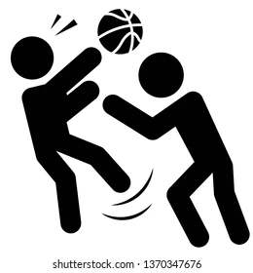
Understanding Personal Fouls in the NBA
Definition
A personal foul occurs when a player engages in illegal physical contact with an opponent, such as holding, pushing, or blocking
Consequences
Team Impact: Accumulating team fouls can lead to the opposing team entering the "bonus," granting them free throws
Player Impact: Individual players who accumulate too many personal fouls risk fouling out of the game
Notes:
KARIM

Slide 5

Fouling Out: Rules and Implications
Threshold
In the NBA, a player is disqualified from the game after committing six personal fouls
Strategic Considerations
Player Management: Coaches must monitor players' foul counts to prevent key players from fouling out
Substitution Decisions: Timely substitutions can help manage foul trouble and maintain team performance
Notes:
KARIM

Slide 6
Problem Statement
Can the Number of Personal Fouls Committed by a Player be Predicted using NBA Box Score Data?
Notes:
KARIM

Slide 7

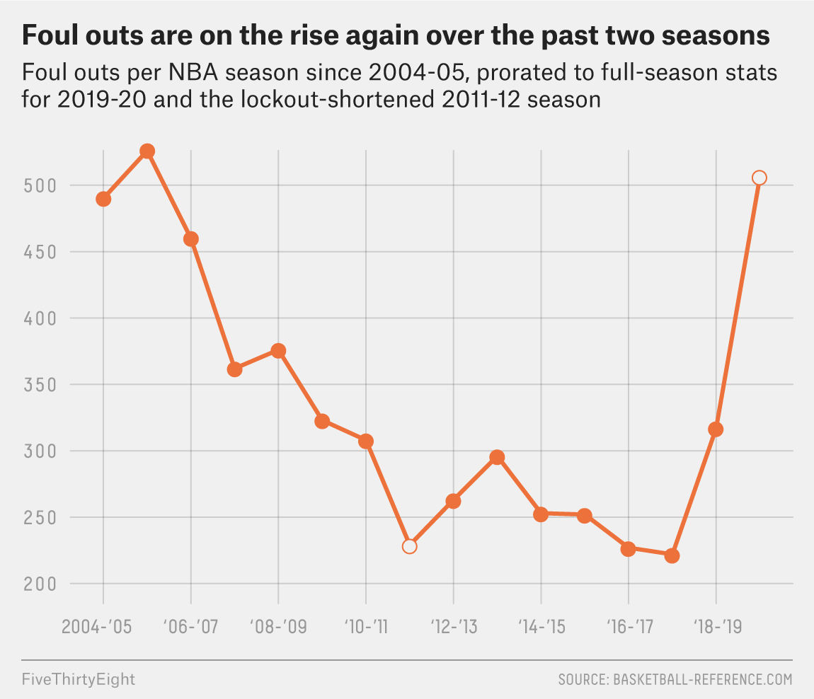



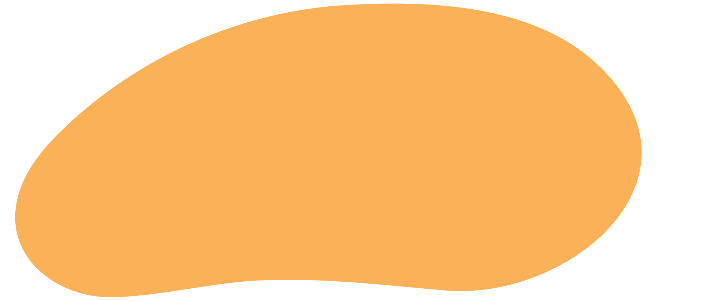

Problem Framing
Who
NBA coaches, players, teams, and data analysts
What
How NBA teams and coaches can use game data to predict fouls and prevent players from fouling out through improved game management
Where and When
NBA games from 2004-2020
Trend: Many analysts argue fouls are being called more easily nowadays
Notes:
KARIM

Slide 8
Problem Framing
Significance of the Problem
Fouls directly impact team performance and game outcomes by giving opposing teams free-throws and leading to players fouling out
If teams can effectively predict when a player is about to foul out, they can make informed substitution decisions and gameplan adjustments
How
Forming predictive models using data from previous seasons
Acknowledging limitations about limited box score data
Notes:
KARIM

Slide 9
Data
Notes:
YUJIN

Slide 10



Data Description
Dataset used: NBA games data (2004-2020) - Collected from Kaggle
Variables included:
MIN, PTS, AST, REB, STL, BLK, TO, PF, OREB etc.
Analyzing box score statistics
Limitations
Lack of spatial data limits analysis
Data stops at 2020
Data does not take into account external factors in a game
Notes:
YUJIN
MIN (Minutes Played)
PTS (Points Scored)
AST (Assists)
REB (Rebounds)
STL (Steals)
BLK (Blocks)
TO (Turnovers)
PF (Personal fouls)
OREB (Offensive Rebounds)
One limitation is the lack of spatial data, that’s restricting us to capture player movements and game dynamics.
Additionally, the dataset only goes up to 2020, leaving out recent trends or changes.
doesn't account for external factors (player injuries, game pressure)

Slide 11
Data Preparation
Data Sources:
Merged games_details.csv (box score data) and games.csv(game data/time data) with game_ID
Data Cleaning:
Replaced all NA/NaN values with 0
Converted GAME_DATE_EST to datetime format.
Filtered out rows where MIN (Minutes Played) =0
Feature Engineering:
Created binary target (Fouled_Out): 1 if PF >= 6, else 0
Computed a 3-game rolling average selected predictors
Predictor Selection:
Selected features: MIN, OREB, PTS, REB, AST, STL, BLK, TO
Notes:
YUJIN
In time-line perspective
To focus on active players
1. Data Collection
Used two datasets:
games_details.csv: Player-level statistics for each game.
games.csv: Game-level statistics including game dates and team results.
2. Data Preparation
Cleaned the data:
Replaced missing values (NaN) with 0.
Converted GAME_DATE_EST to datetime format for date-based analysis.
Filtered rows where MIN (Minutes Played) = 0 to focus on active players.
Created new features:
OREB_avg_3: Rolling average of offensive rebounds over the last 3 games.
Binary target (Fouled_Out): 1 if PF >= 6, else 0 (for classification tasks).
****
MIN (Minutes Played)
OREB (Offensive Rebounds)
PTS (Points Scored)
REB (Rebounds)
AST (Assists)
STL (Steals)
BLK (Blocks)
TO (Turnovers)

Slide 12
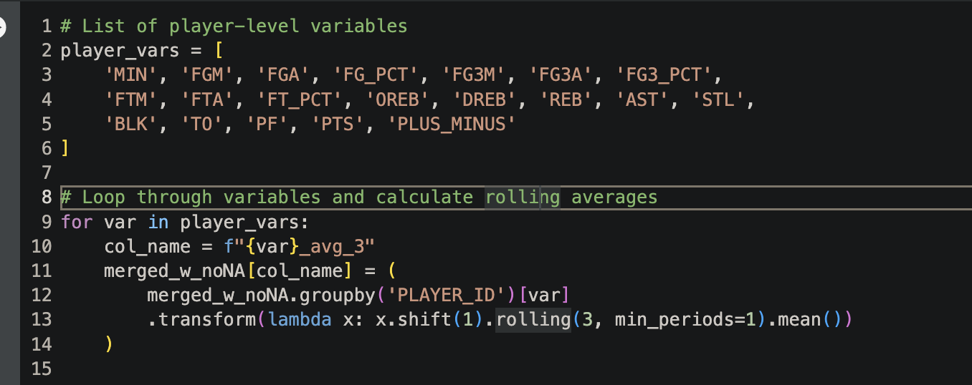
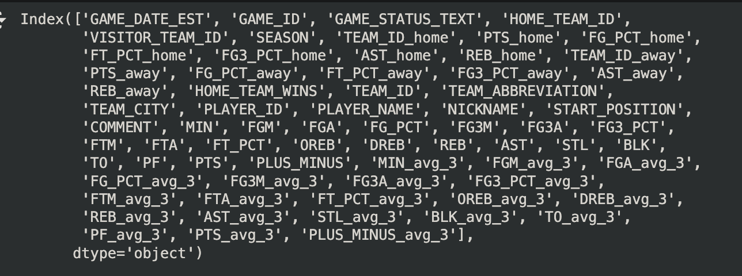
Variables Used
Notes:
For the pre-processing and used these for analysis.
****
MIN (Minutes Played)
OREB (Offensive Rebounds)
PTS (Points Scored)
REB (Rebounds)
AST (Assists)
STL (Steals)
BLK (Blocks)
TO (Turnovers)

Slide 13
Exploratory Analysis
Notes:
KARIM

Slide 14
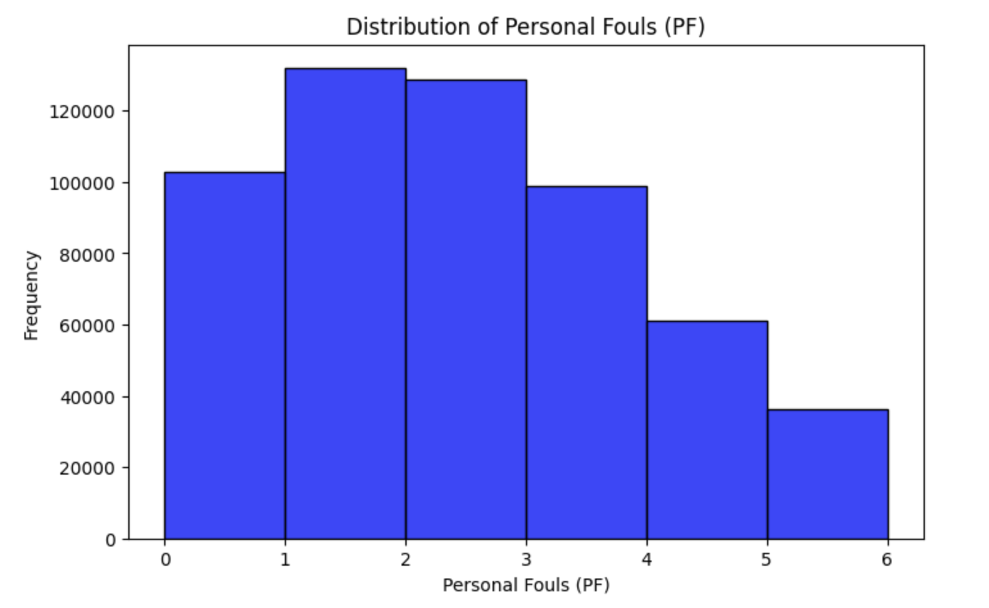
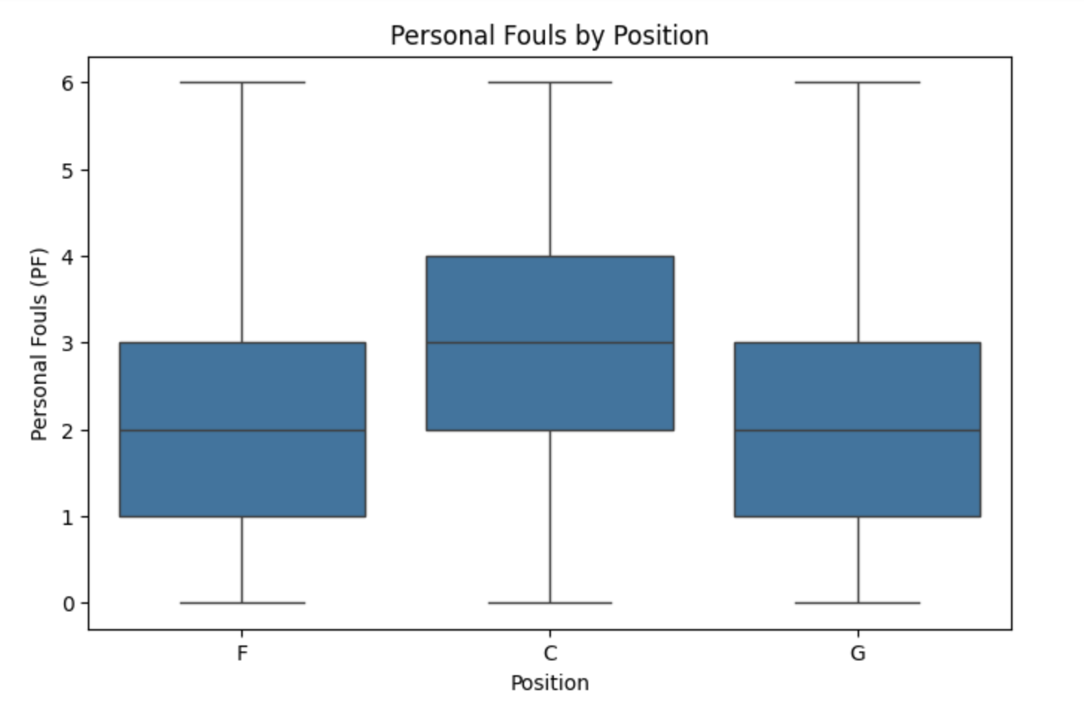
Exploratory Analysis
Most players maintain 3 PF or less
Yet there is still a good amount of players with 4+ PF
Centers exhibit the highest median
Guards commit the least amount of fouls
Notes:
KARIM

Slide 15
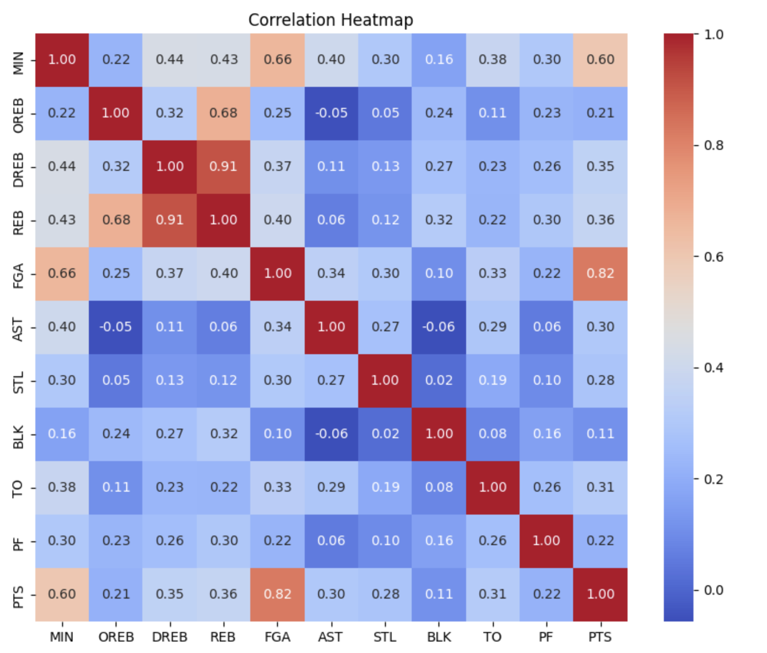
Exploratory Analysis
Key Findings
Player Minutes (MIN):
Highest correlation with PTS (Points Scored) and PF (Personal Fouls)
Rebounds (REB):
Higher REB correlates with higher fouls and predicts player activity
Turnovers (TO) and Rebounds (REB):
Show diverse but important relationships with fouling out
Notes:
YUJIN
At first glance, variables may not seem highly correlated to Personal Fouls
But from the selected variables, MIN, REB, and TO seem to correlate with PF the most
This leaves room for further analysis to be done

Slide 16
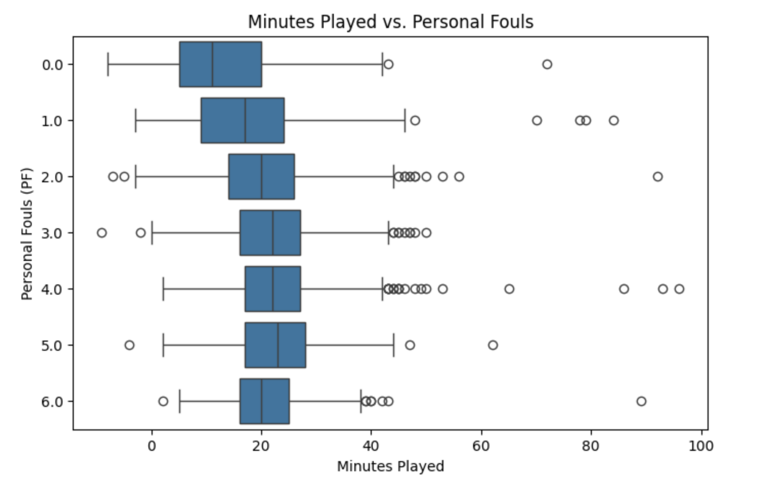
Exploratory Analysis
Key Findings
Generally a positive trend between fouls and playing time
More minutes -> Higher likelihood of fouling
Outliers may represent exceptionally disciplined or efficient players
Notes:
KARIM
The plot highlights a general positive trend between fouls and playing time, reinforcing the idea that personal fouls are often tied to higher minutes of engagement in a game.
Outliers with high playing time and low fouls may represent exceptionally disciplined or efficient players.

Slide 17
Methods

Slide 18
Method
Data Collection
Data Preparation
Modeling
Evaluation
Notes:
Modeling
Decision Tree Regressor:
Predicted the continuous target variable (PF - Personal Fouls).
Visualized the splits and identified feature importance.
Logistic Regression Model:
Predicted binary target: 1 = Fouled Out, 0 = Not Fouled Out).
Incorporated top predictors (MIN, OREB_avg_3, and TO).
5. Model Evaluation
For the Decision Tree Regressor:
Evaluated performance using R-squared and scatter plots (True vs. Predicted).
For Logistic Regression:
Used classification metrics (Precision, Recall, F1-Score) and confusion matrix.

Slide 19


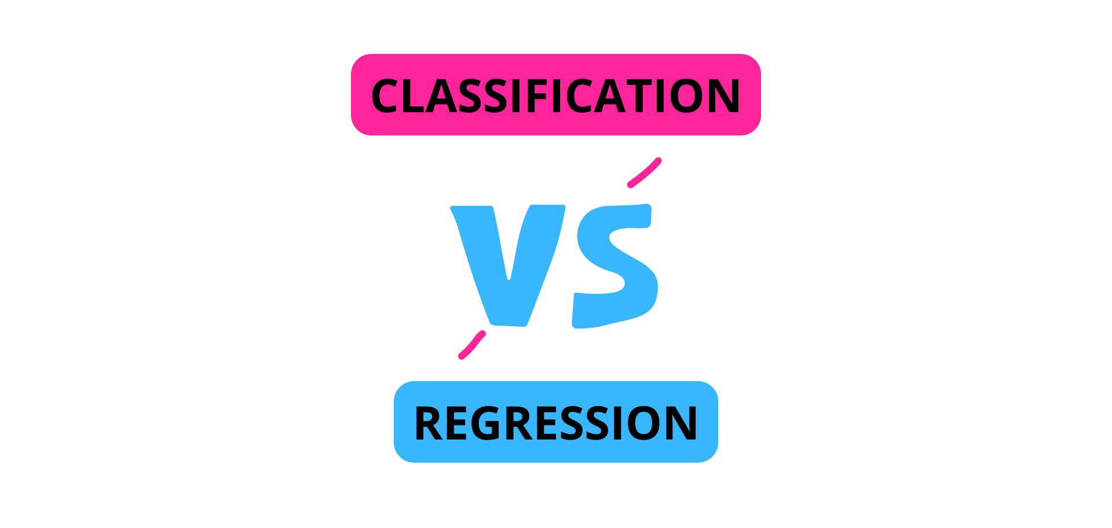
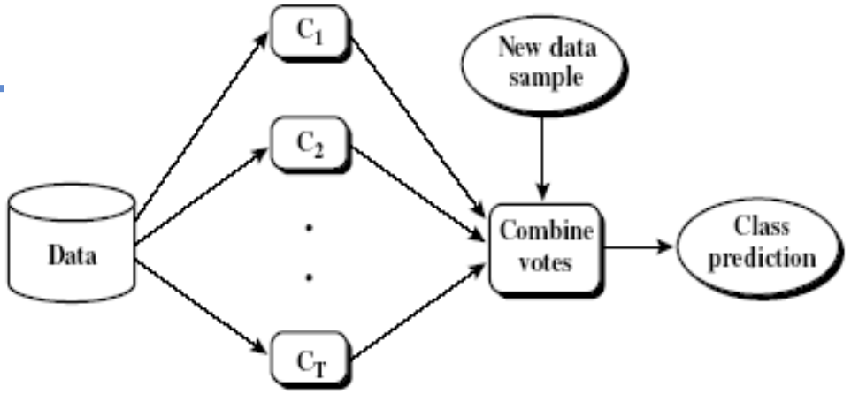
Models Used
Baseline Comparison Models
Single Decision Trees
Ensemble Tree Methods
Compare to Regression and “leakage” Models
Try to create explainable rules
Try to improve performance
Notes:
DT - for the sake of comparison
On the past 3 avg
Ensemble

Slide 20

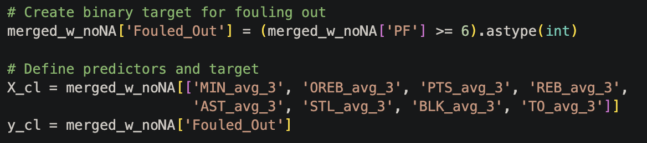
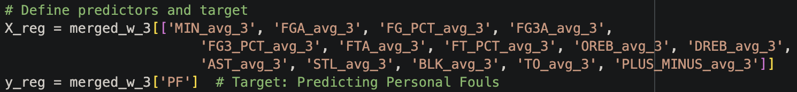
Regression vs Classification
Tries to specifically predict the number of fouls a player will give
No new target variable is created
Decision tree splits to leafs on numbers (1, 2, 3, etc.)
Predictions may not be whole numbers (2.4), affecting interpretation
Tries to specifically predict whether a player will foul out of a game (give 6+ personal fouls
Requires new target variable “Fouled Out” (1 if PF >= 6), which is rare
Decision tree splits to leafs if Fouled Out = 1 or 0
Does not predict specific number of fouls

Slide 21
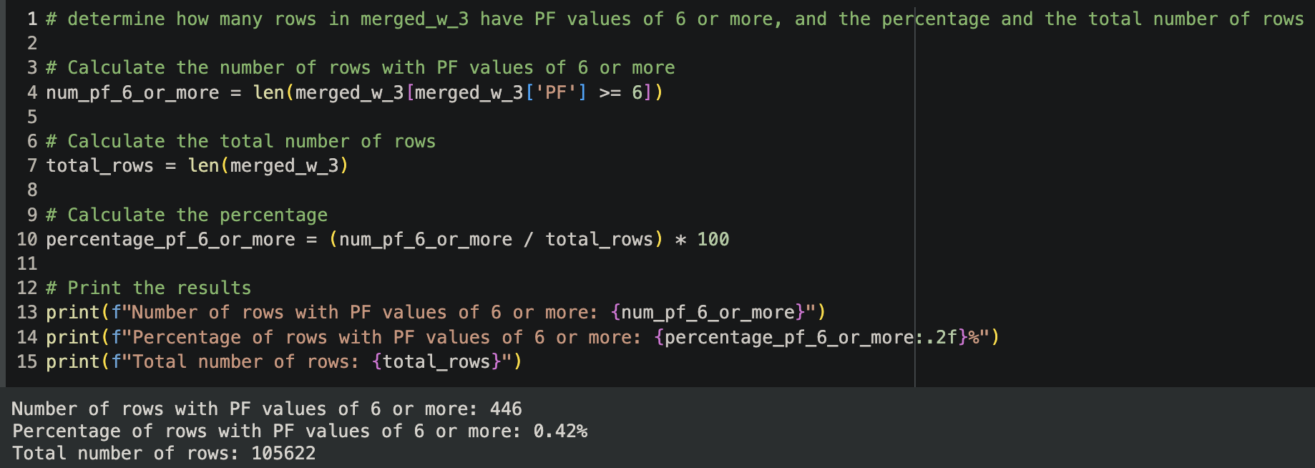
Regression vs Classification

Slide 22
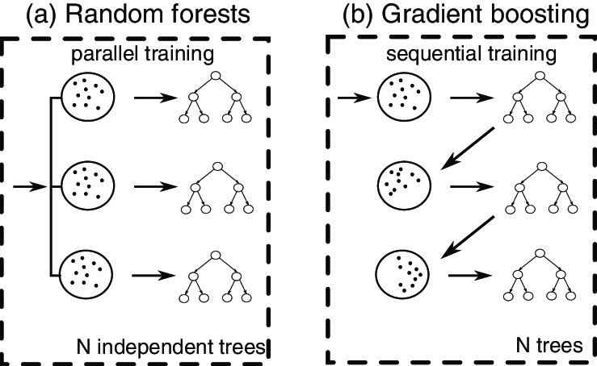
Ensemble Tree Models
Ensemble models combine multiple trees to improve effectiveness
Random Forest: Trains many trees in parallel and averages classification predictions into final combined model
Gradient Boosting: Trains single trees sequentially, improving from past mistakes
Classification ensemble models were used and also tested with adjusted hyperparameters (which did not improve effectiveness)

Slide 23
Results

Slide 24
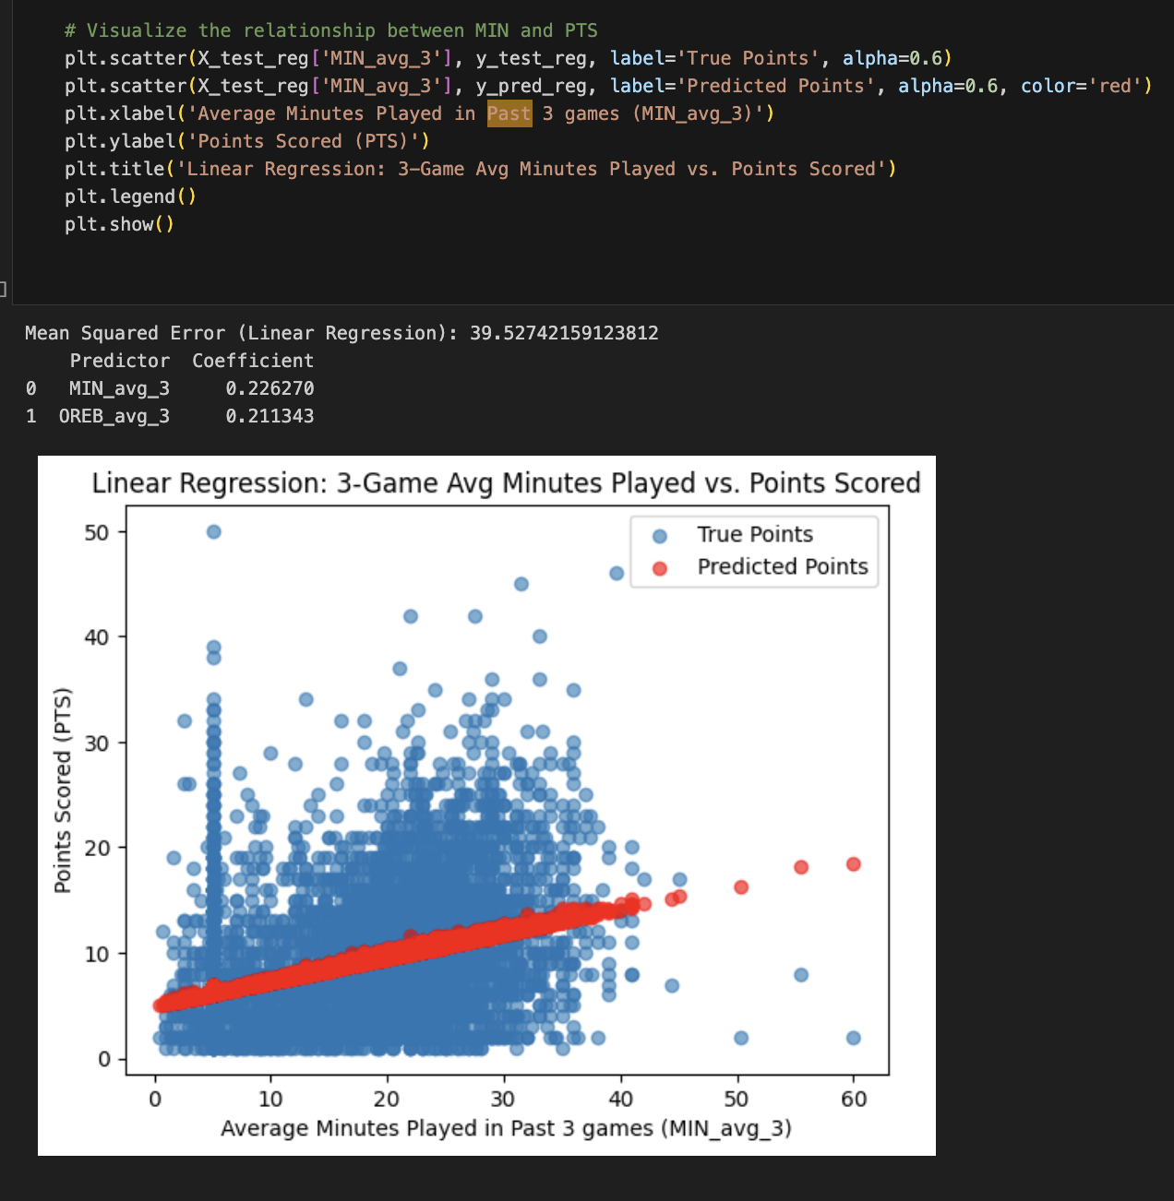
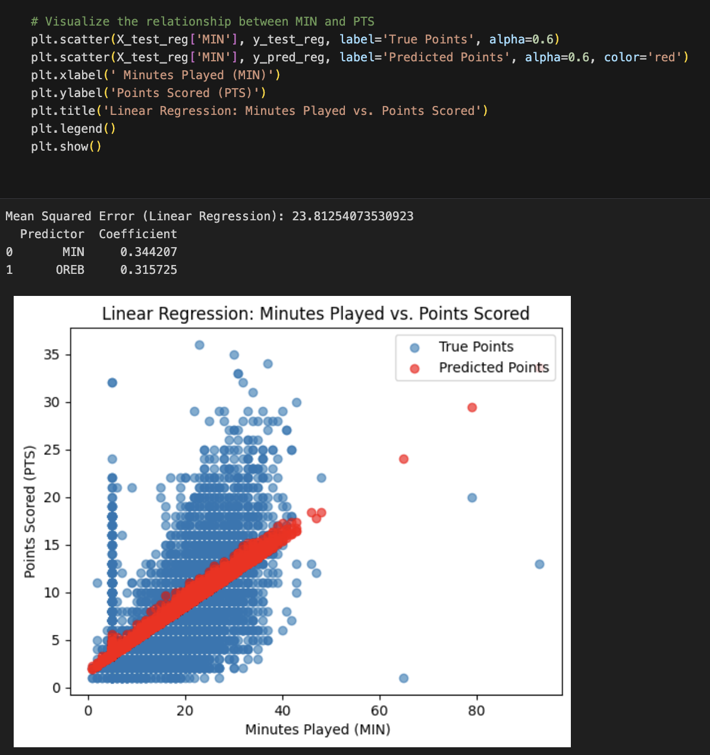
Baseline
Notes:
Data-driven decision-making in high-stakes environments
Basketball Teams and Coaches: Teams can leverage the spatial tracking data to optimize strategies
Players: Individual athletes benefit by understanding how they perform in specific situations
General Managers and Front Offices: They can use this data to make more informed decisions on trades, draft picks, and contract negotiations.
Analysts and Data Scientists in Sports: This data gives analysts tools to create predictive models for game performance and identify trends over time.
Fans and Sports Media: Advanced metrics derived from the data offer deeper insights into the game, creating more engaging content for fans.

Slide 25
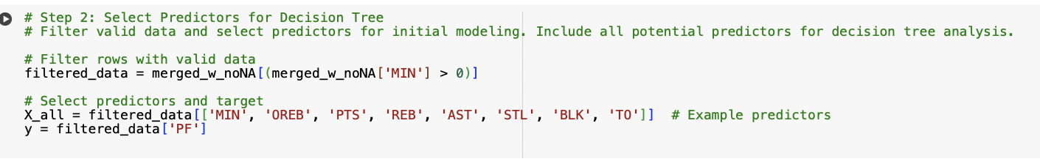
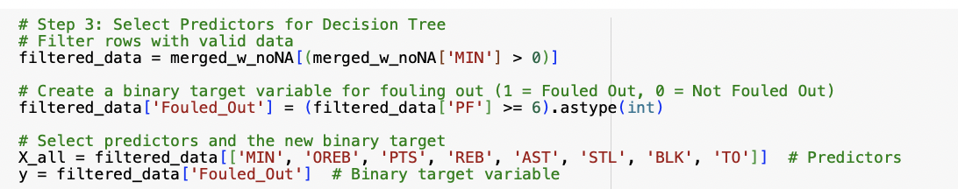
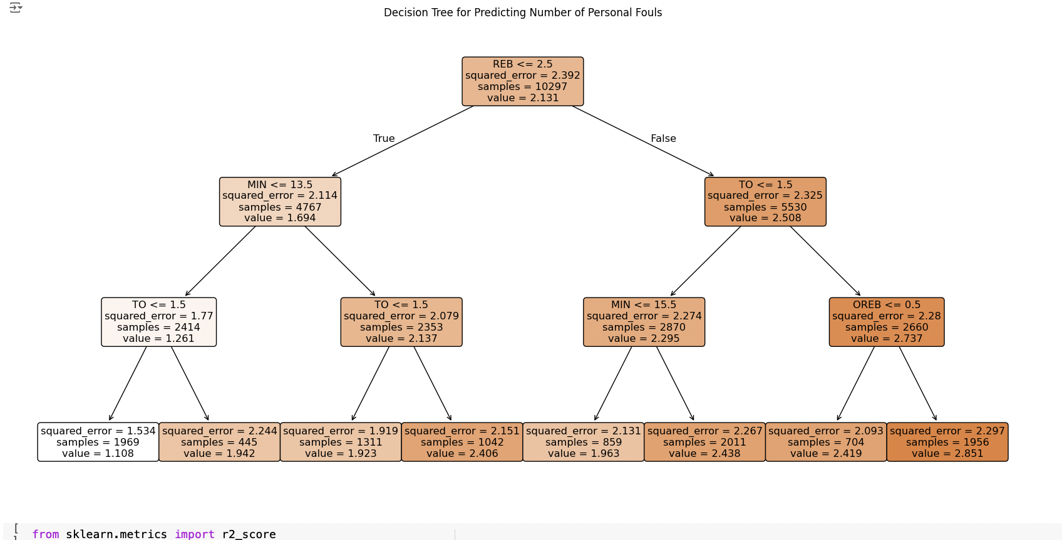
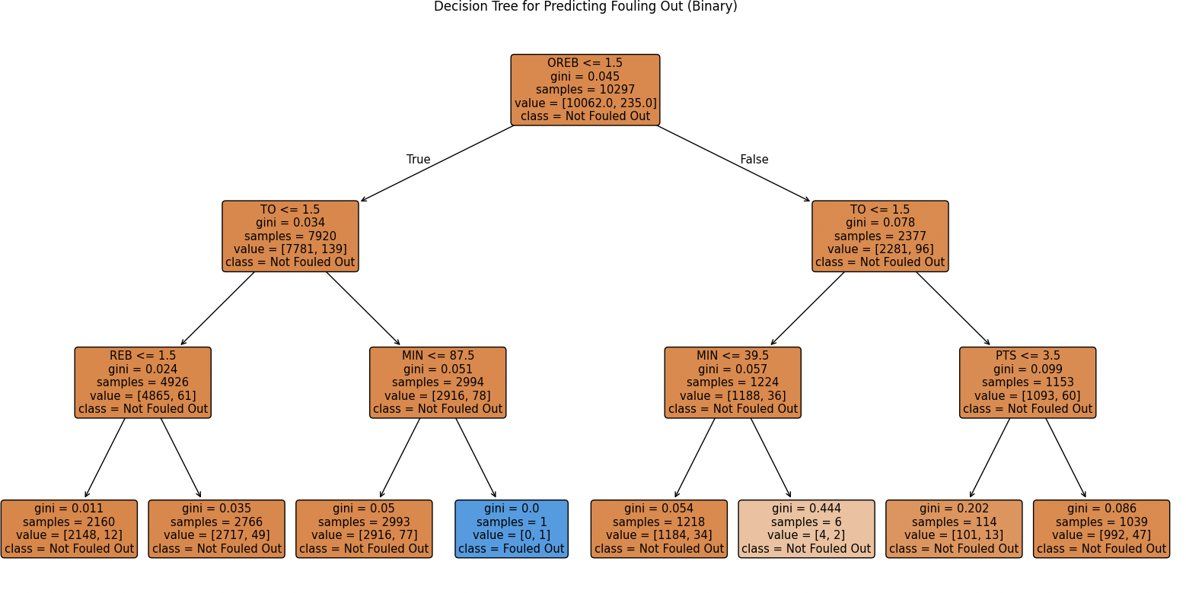
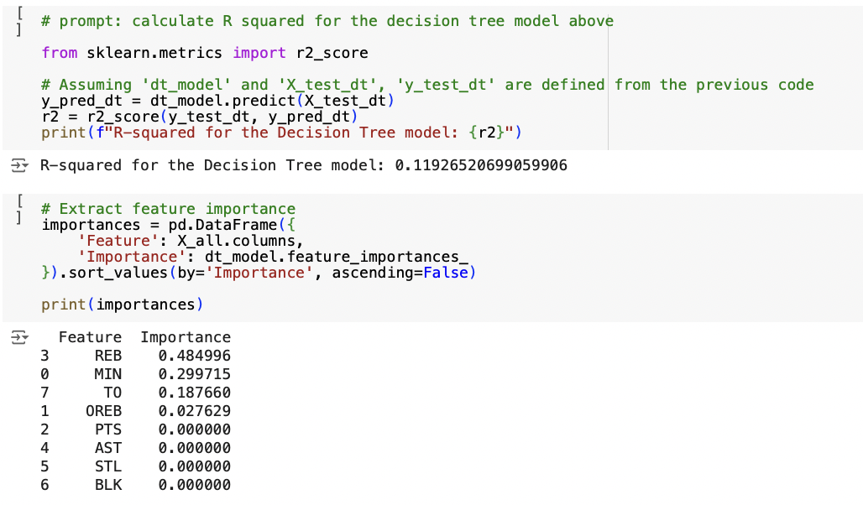
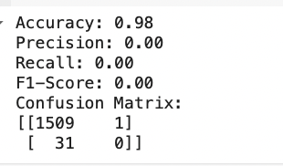
Present Variable Model
Regression DT
Classification DT

Slide 26
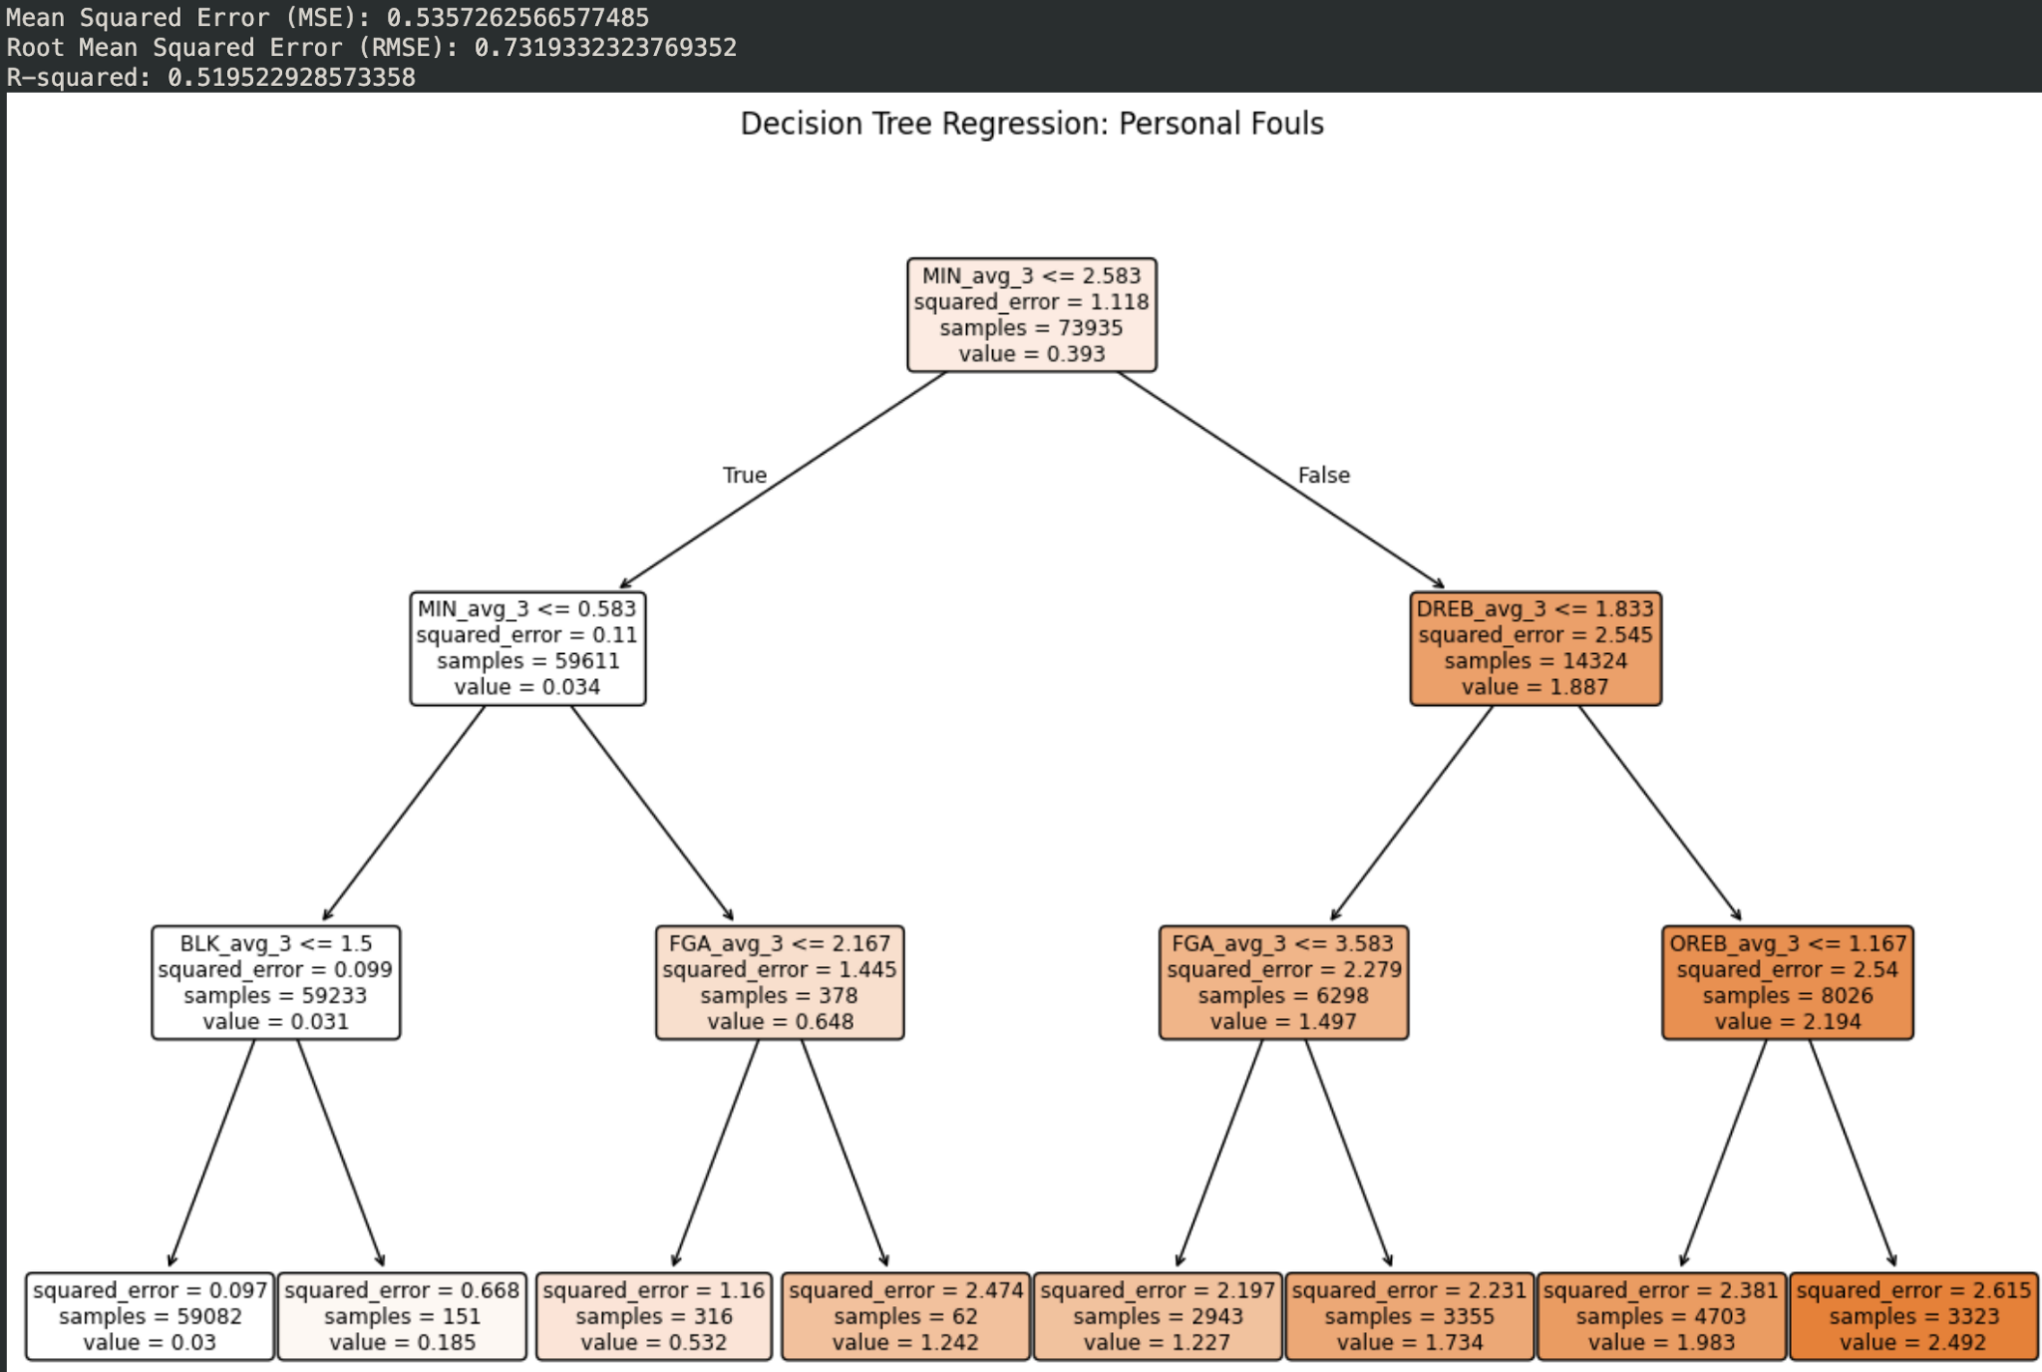
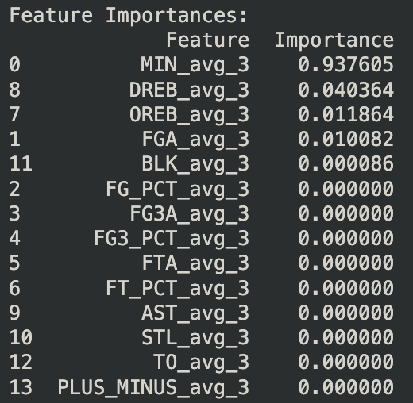
Prev 3 Regression DT
Y: PF (Personal Fouls)
Notes:
Data-driven decision-making in high-stakes environments
Basketball Teams and Coaches: Teams can leverage the spatial tracking data to optimize strategies
Players: Individual athletes benefit by understanding how they perform in specific situations
General Managers and Front Offices: They can use this data to make more informed decisions on trades, draft picks, and contract negotiations.
Analysts and Data Scientists in Sports: This data gives analysts tools to create predictive models for game performance and identify trends over time.
Fans and Sports Media: Advanced metrics derived from the data offer deeper insights into the game, creating more engaging content for fans.

Slide 27
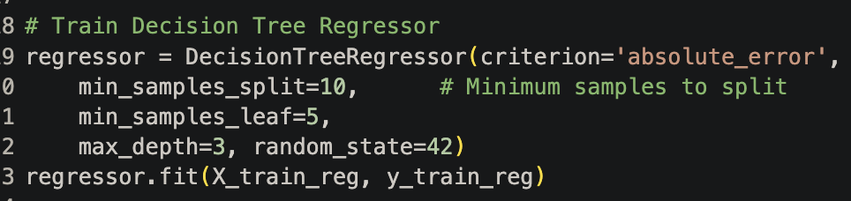
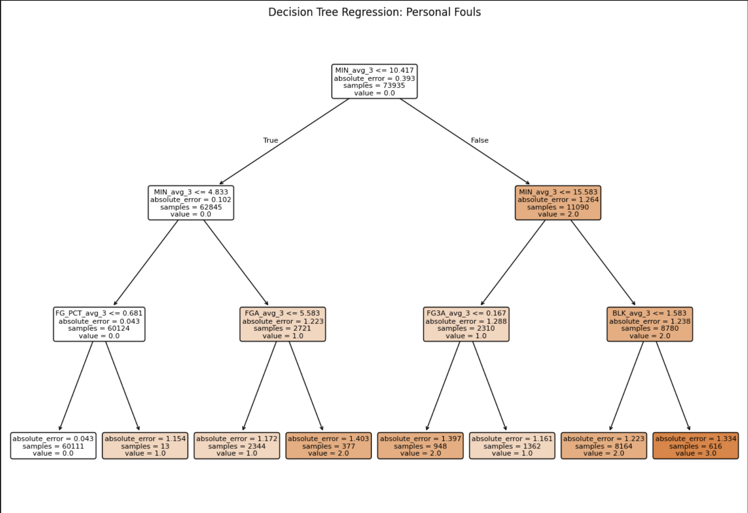
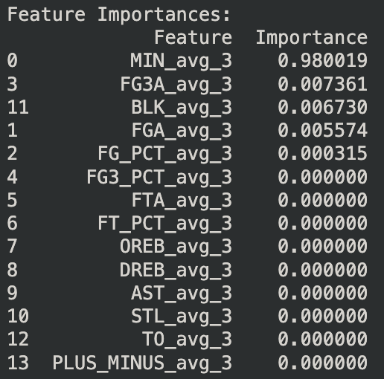
Prev 3 Regression Adjusted
Notes:
With specifici hyperparameters like split, leat…

Slide 28
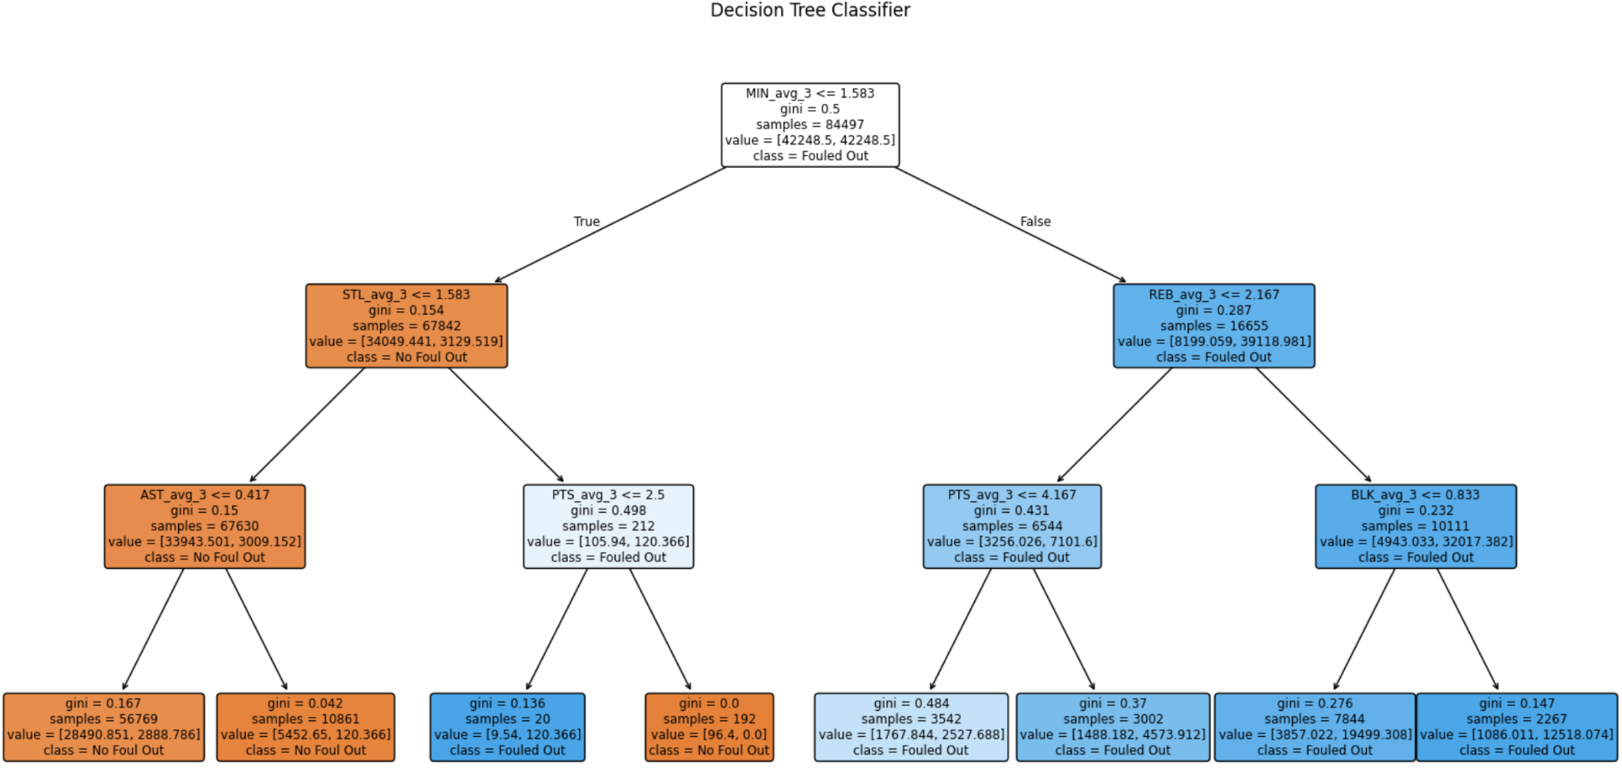
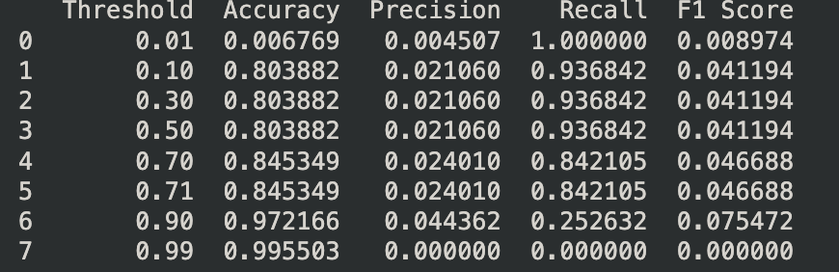
Prev 3 Classification
Y : Fouled_Out (binary as 1/0)
Notes:
Data-driven decision-making in high-stakes environments

Slide 29
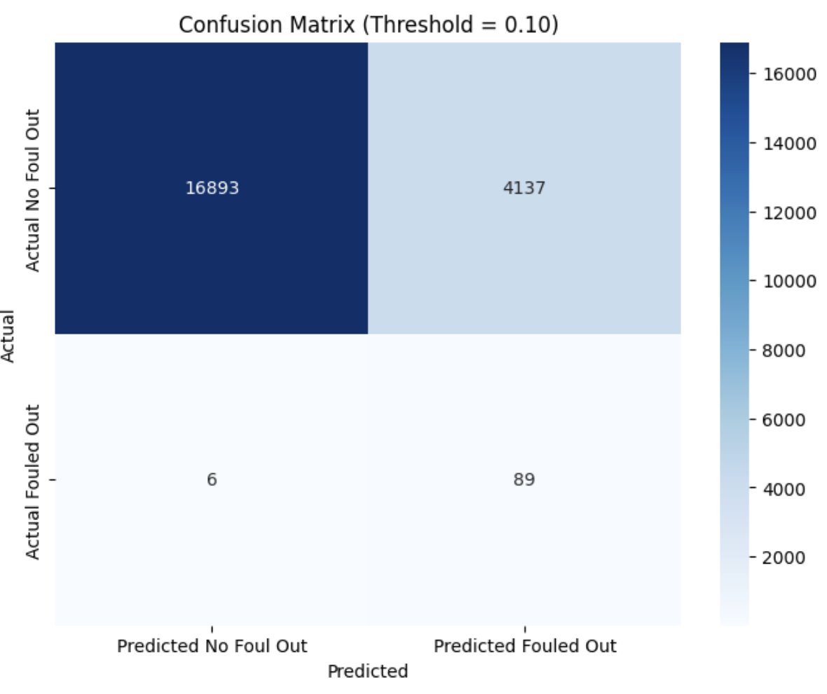
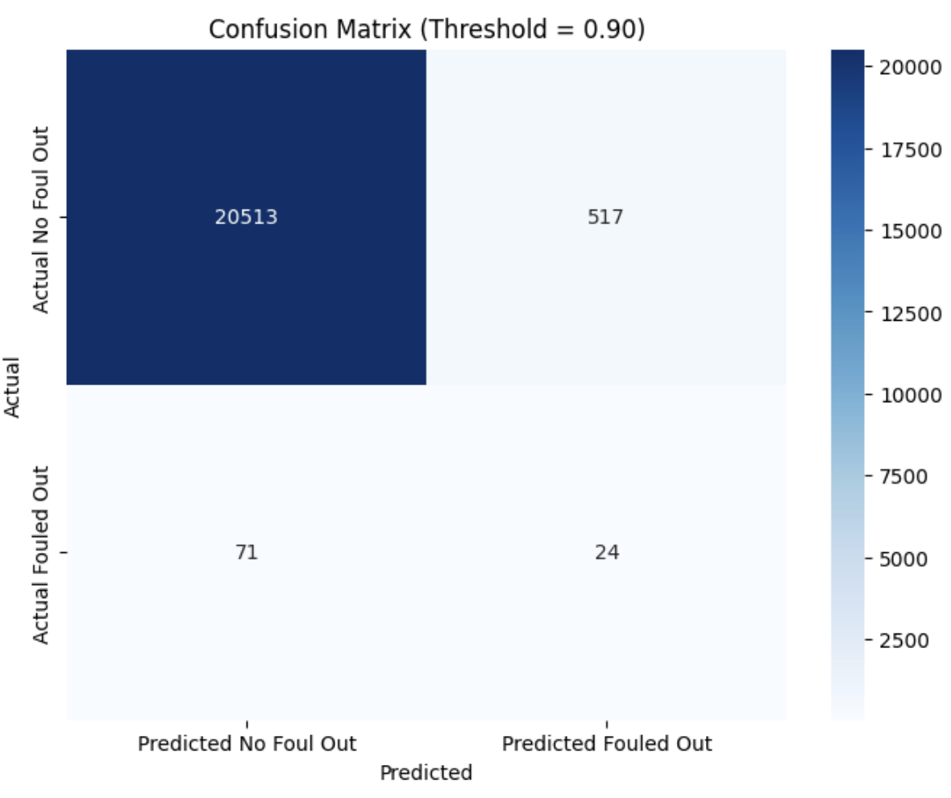
Prev 3 Classification
With different thresholds

Slide 30
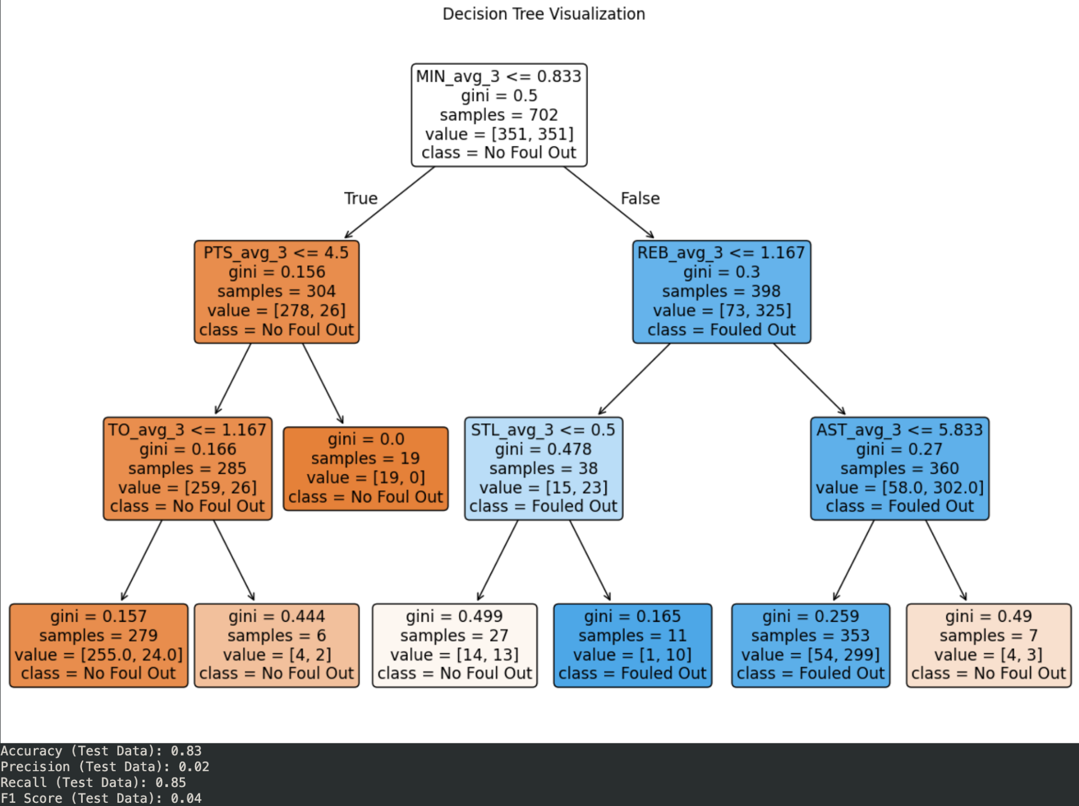
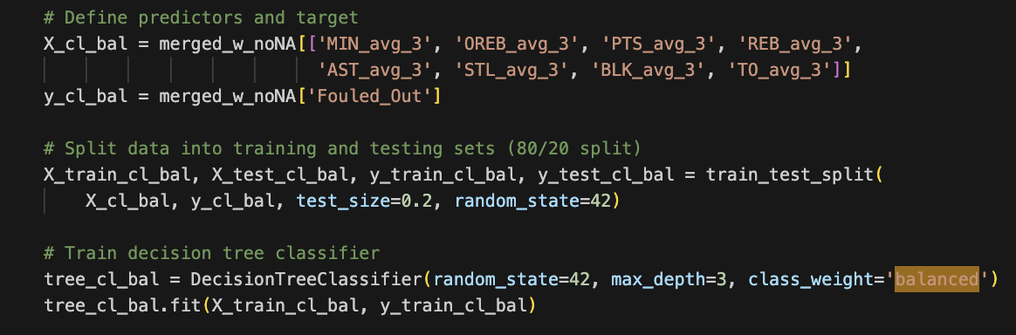
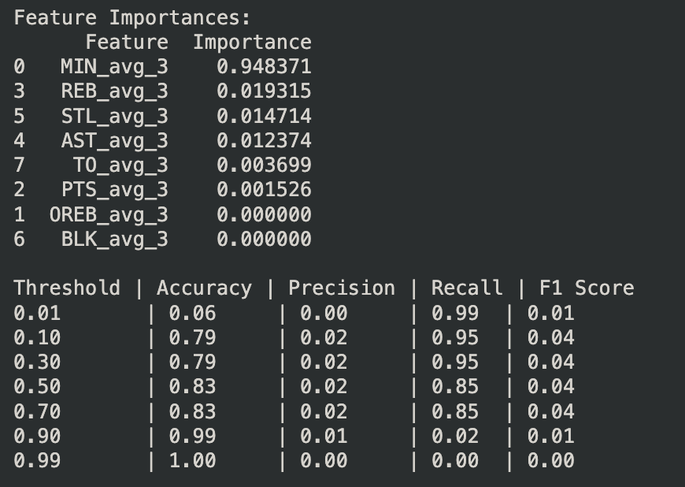
Class “balanced”

Slide 31

Class “balanced”

Slide 32
Ensemble Models

Slide 33
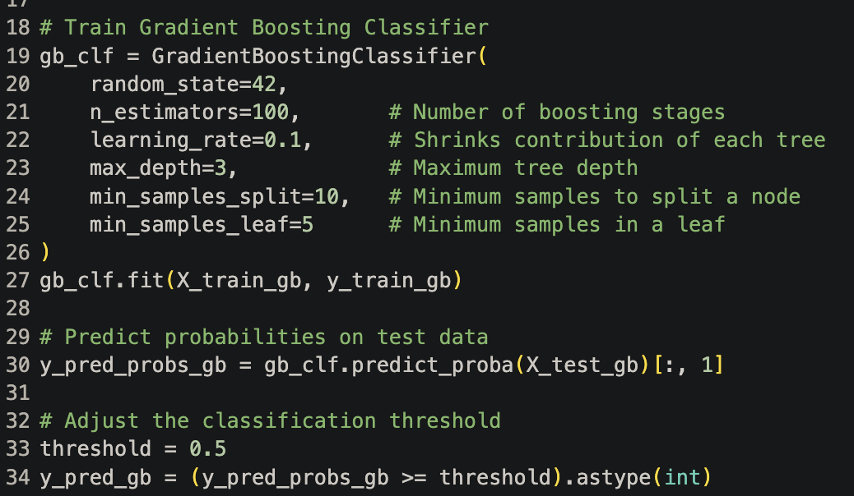
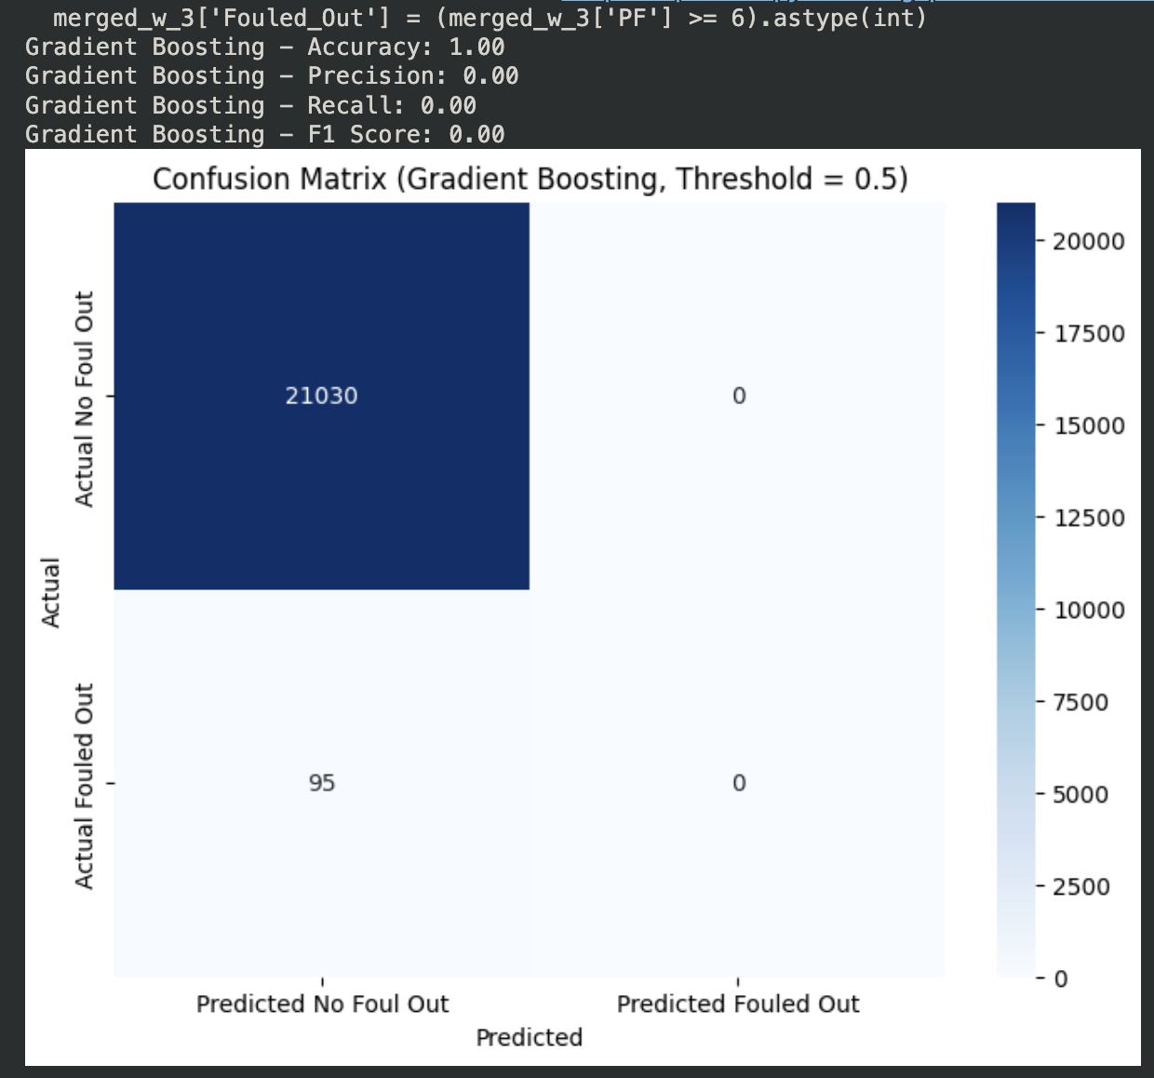
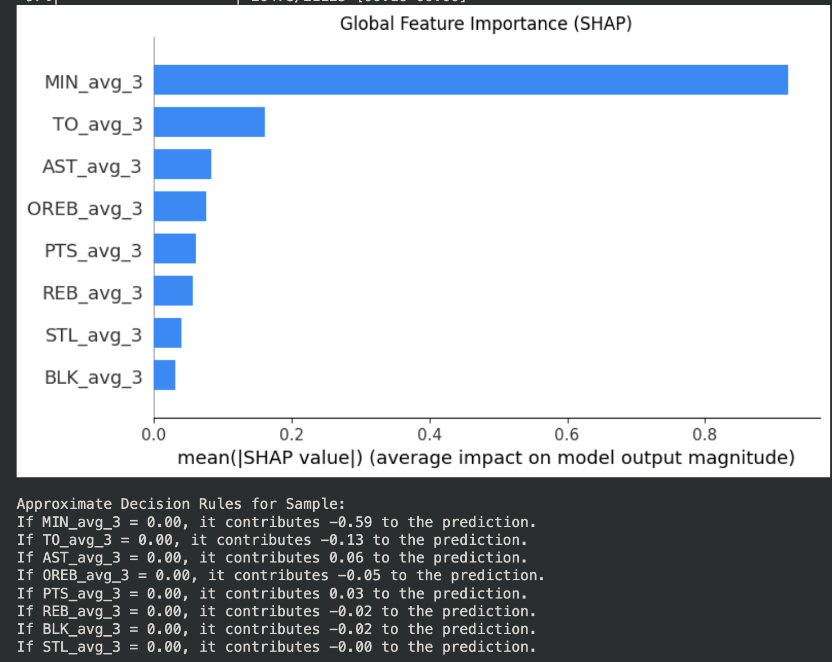
Gradient Boosting Classification
Standard GB model fails because it classifies all players as negative (not fouling out)
Trains n (100) trees sequentially, each with a max depth of 3, then average across all trees at standard decision threshold (0.5)
MIN (avg across past 3 games) most important factor in model
Adjust for the next round
Notes:
Data-driven decision-making in high-stakes environments
Basketball Teams and Coaches: Teams can leverage the spatial tracking data to optimize strategies
Players: Individual athletes benefit by understanding how they perform in specific situations
General Managers and Front Offices: They can use this data to make more informed decisions on trades, draft picks, and contract negotiations.
Analysts and Data Scientists in Sports: This data gives analysts tools to create predictive models for game performance and identify trends over time.
Fans and Sports Media: Advanced metrics derived from the data offer deeper insights into the game, creating more engaging content for fans.

Slide 34
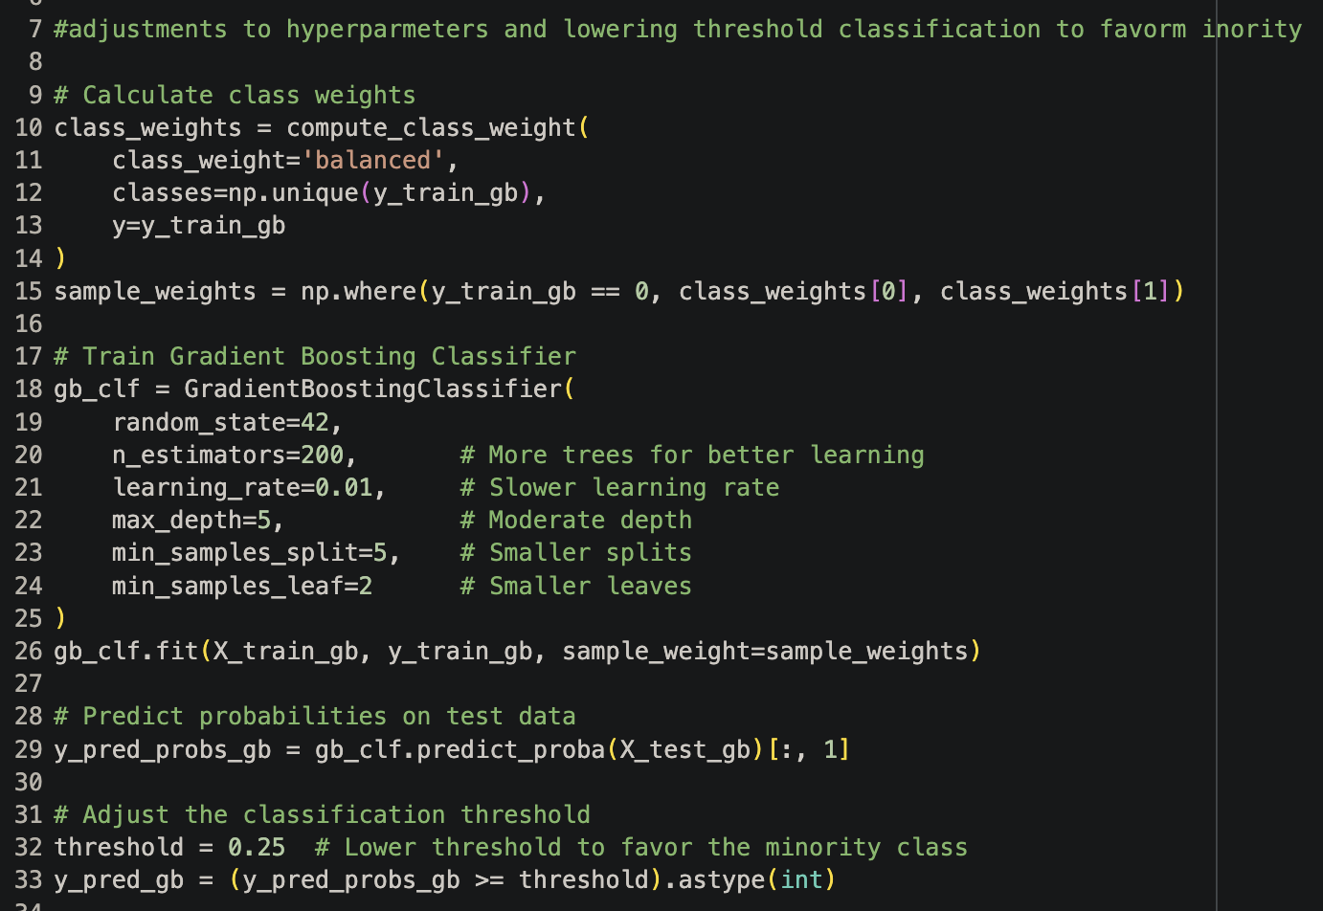
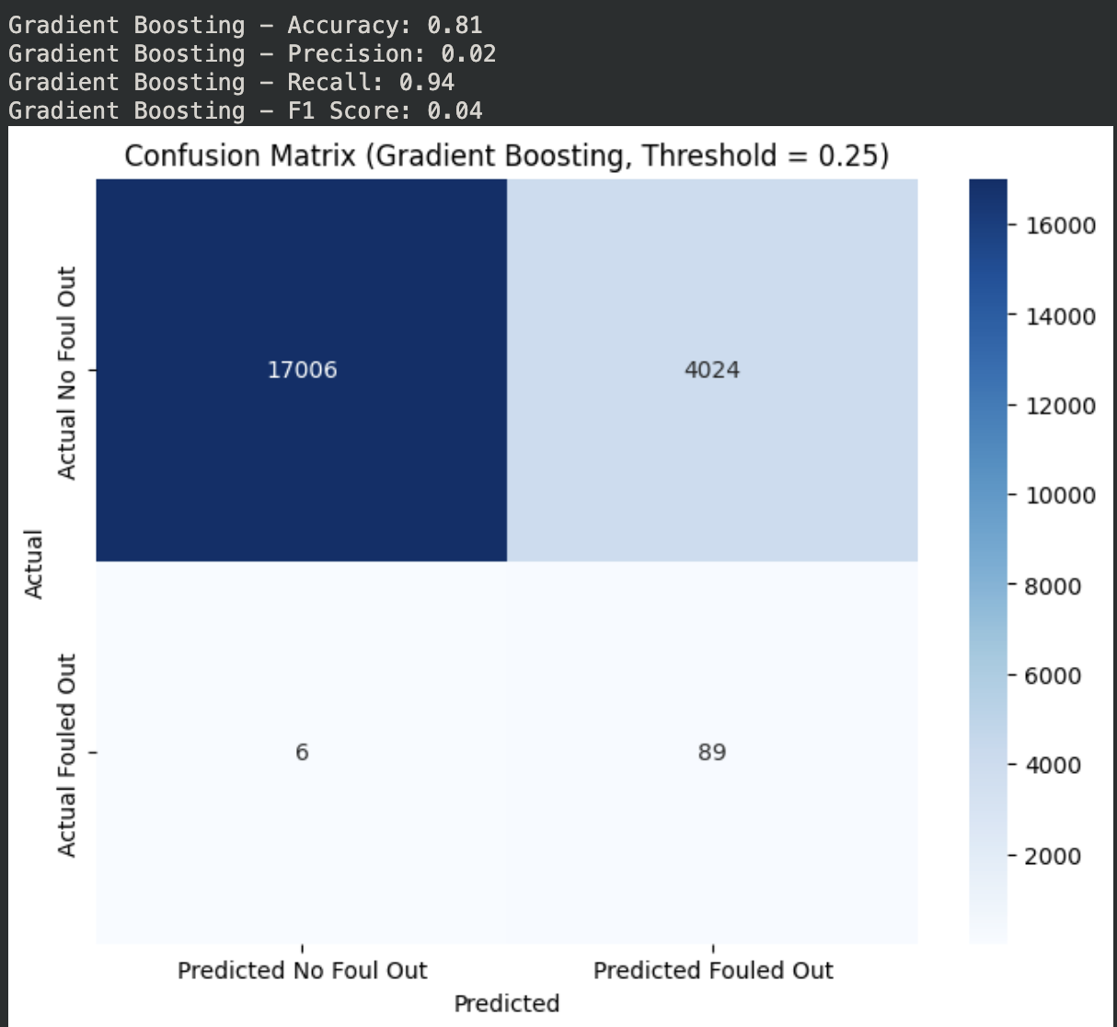
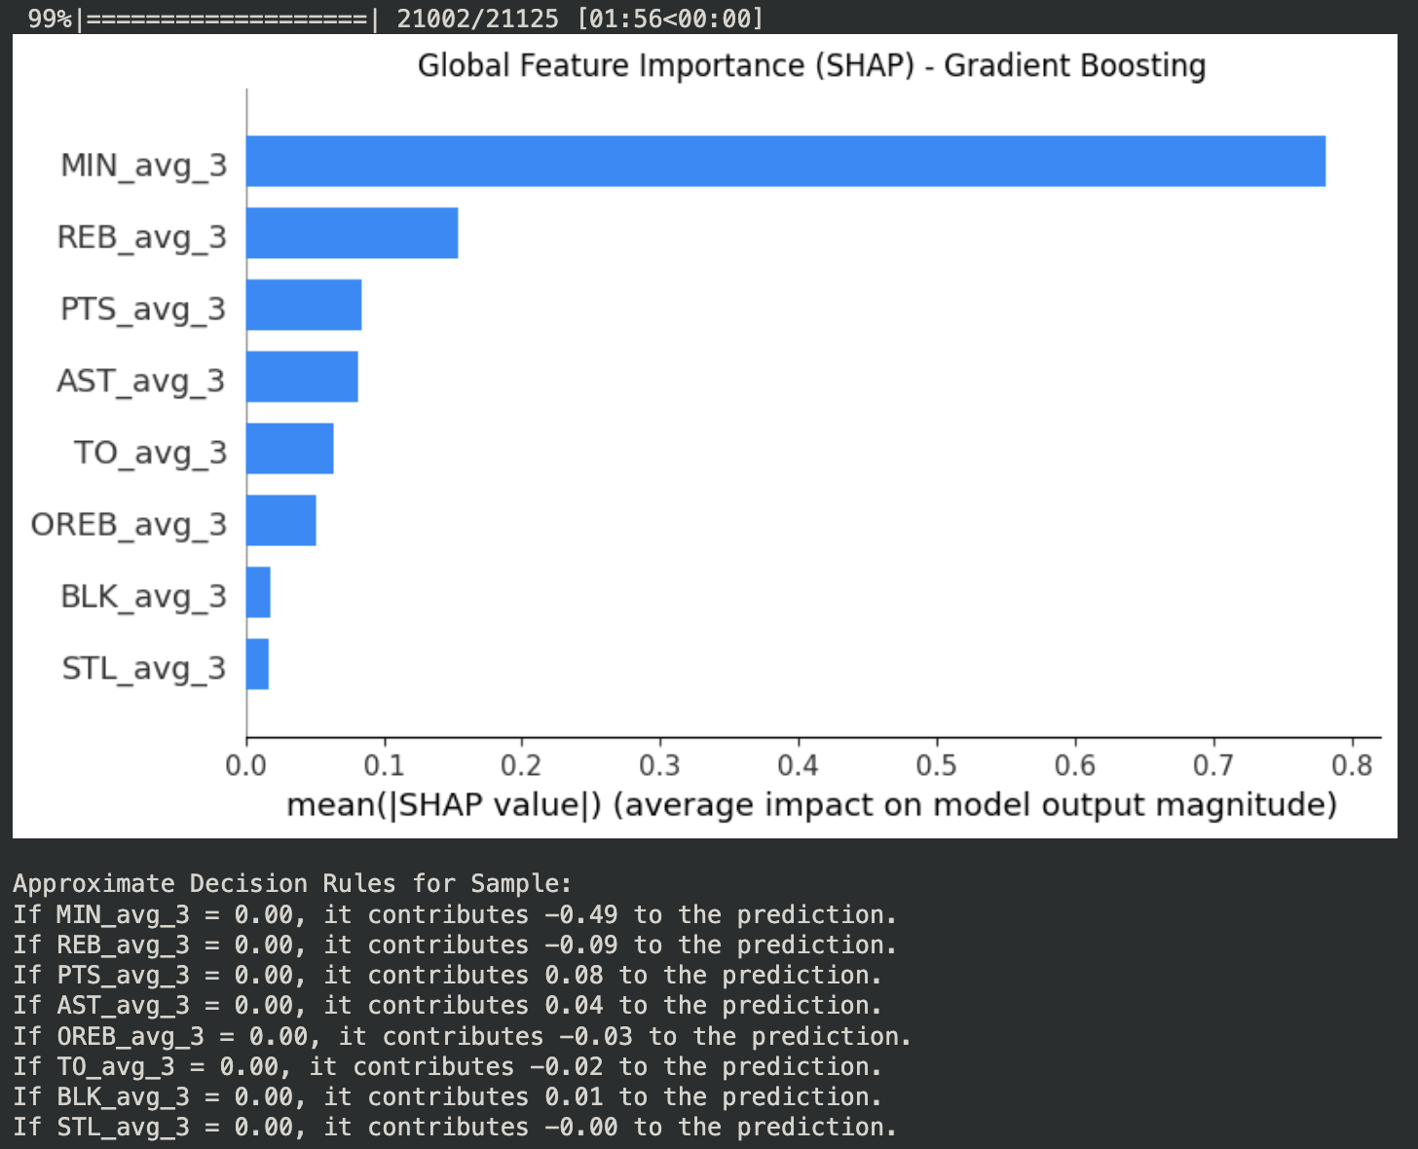
GB Modified
Modified GB shows significant change but minimal improvement
Set class_weight to “balance” uneven classes, add more trees with smaller splits
Now categorizing players as fouling out, but “false positives”
F1 score (balances Precision vs. Recall) increase 0 → 0.04 on scale of 0-1
About as good as the balanced single decision tree (but still poor)
Notes:
Data-driven decision-making in high-stakes environments
Basketball Teams and Coaches: Teams can leverage the spatial tracking data to optimize strategies
Players: Individual athletes benefit by understanding how they perform in specific situations
General Managers and Front Offices: They can use this data to make more informed decisions on trades, draft picks, and contract negotiations.
Analysts and Data Scientists in Sports: This data gives analysts tools to create predictive models for game performance and identify trends over time.
Fans and Sports Media: Advanced metrics derived from the data offer deeper insights into the game, creating more engaging content for fans.

Slide 35
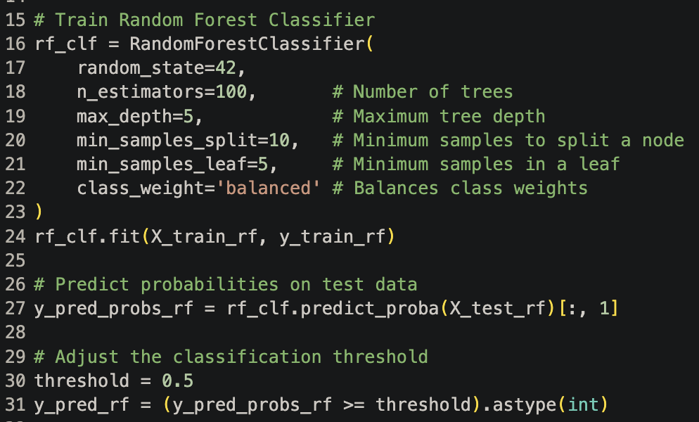
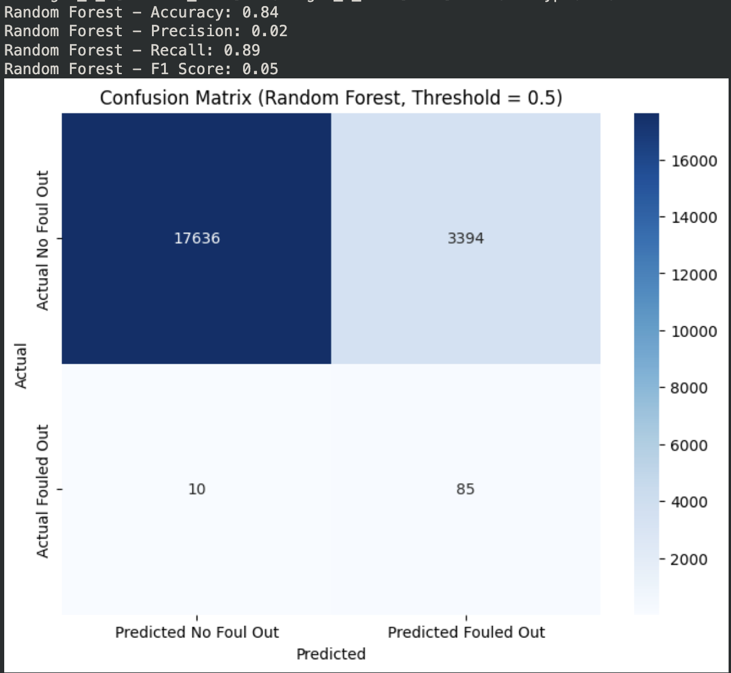
Random Forest
Standard RF model has F1 score of 0.05, minimal improvement above GB or single Decision tree
Trains n (100) trees in parallel, each with a max depth of 3, then average across all trees at standard decision threshold (0.5), class “balanced”
Heavy false positive misclassification
Notes:
Data-driven decision-making in high-stakes environments
Basketball Teams and Coaches: Teams can leverage the spatial tracking data to optimize strategies
Players: Individual athletes benefit by understanding how they perform in specific situations
General Managers and Front Offices: They can use this data to make more informed decisions on trades, draft picks, and contract negotiations.
Analysts and Data Scientists in Sports: This data gives analysts tools to create predictive models for game performance and identify trends over time.
Fans and Sports Media: Advanced metrics derived from the data offer deeper insights into the game, creating more engaging content for fans.

Slide 36
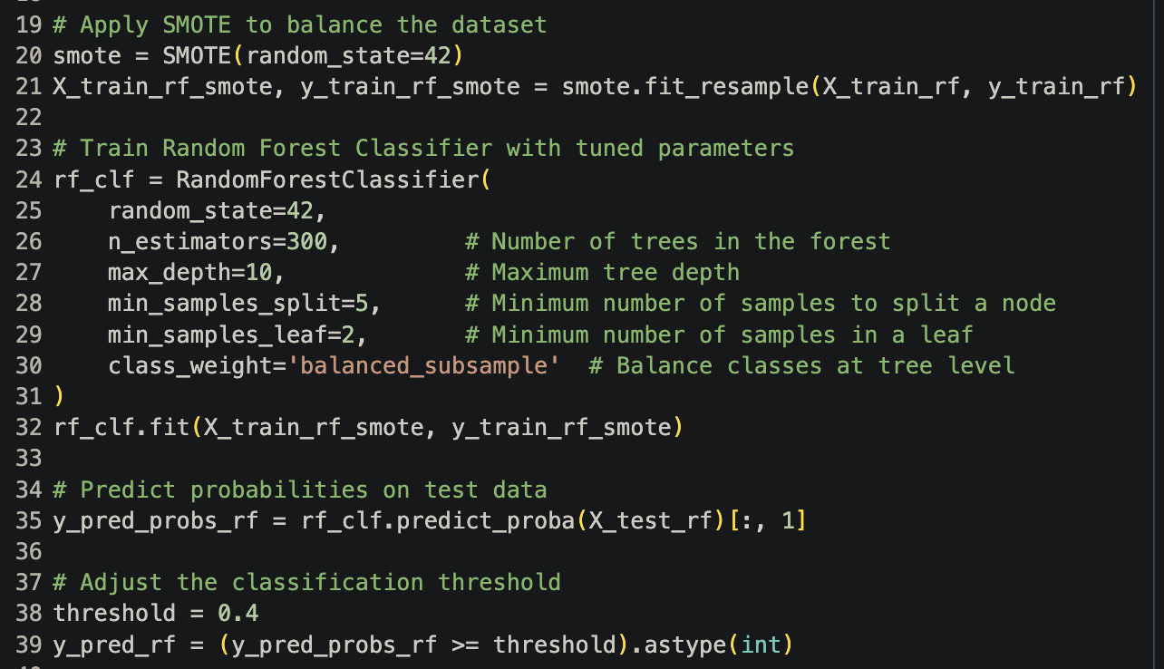
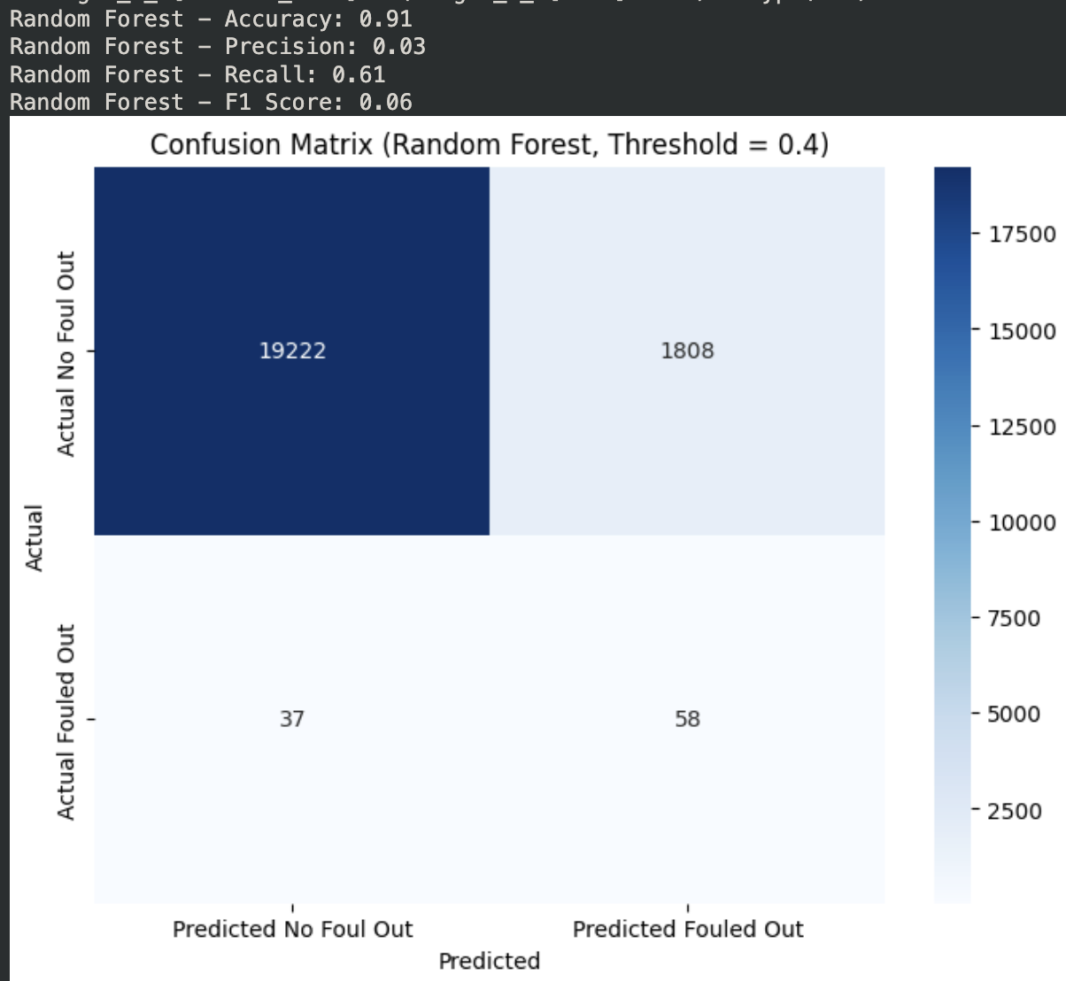
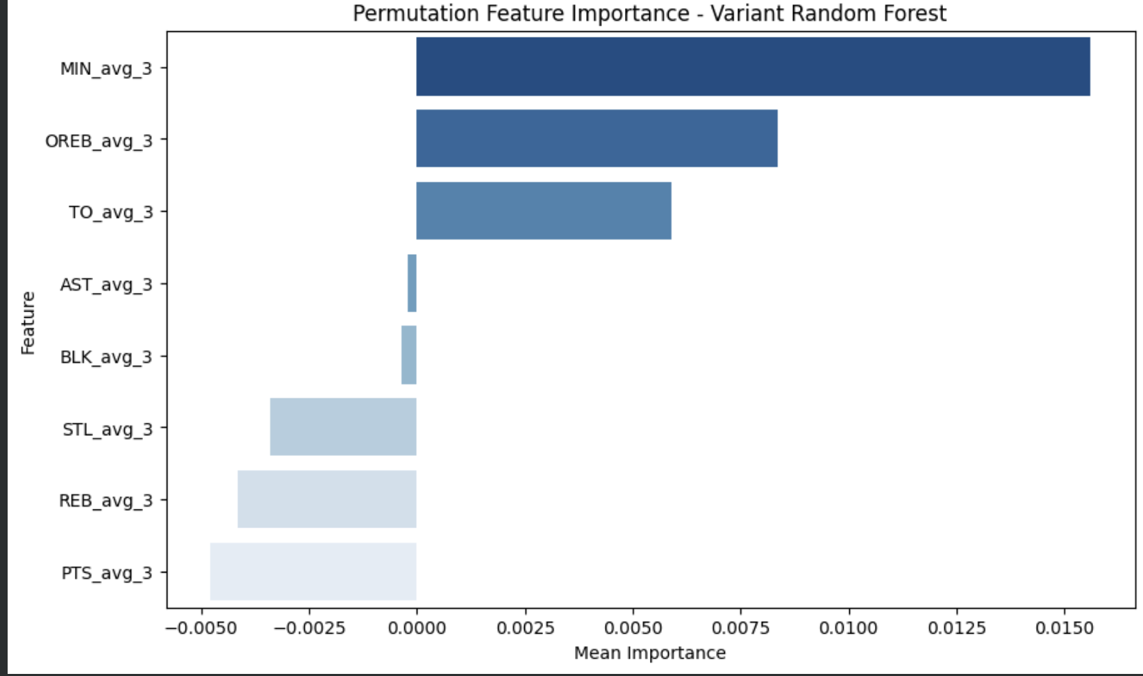
RF Modified
Performs the best of all models but only 0.06 F1 Score, major misclassification, poor precision
Applied “SMOTE” minority class (foul out) oversampling to adjust for class imbalance
Similar feature importance as all other models, MIN (avg_3) clearly most important across different trees
Notes:
Data-driven decision-making in high-stakes environments
Basketball Teams and Coaches: Teams can leverage the spatial tracking data to optimize strategies
Players: Individual athletes benefit by understanding how they perform in specific situations
General Managers and Front Offices: They can use this data to make more informed decisions on trades, draft picks, and contract negotiations.
Analysts and Data Scientists in Sports: This data gives analysts tools to create predictive models for game performance and identify trends over time.
Fans and Sports Media: Advanced metrics derived from the data offer deeper insights into the game, creating more engaging content for fans.

Slide 37
Conclusion
Notes:
KARIM

Slide 38

Stakeholder Review
Current findings: The current models requires further refinement and are not effective in solving the question
Key Insight: Analysis proved that player-game box score data were not effective predictors of PF
Challenges: Unable to access necessary data to address problem statement
Recommendations
Notes:
KARIM
For the primary stakeholder, we believe this model need work and improvement to answer the question and should not be used at this time.
From our current research we determined that in our models, player-game box score data were not accurate predictors of a player's amount of fouls in future games.
Ultimately, we were not able to get the data needed to answer the question, nor were the models able to be tuned to improve performance. We will continue in the next slides to recommend how we would

Slide 39
Future Steps
Notes:
KARIM

Slide 40
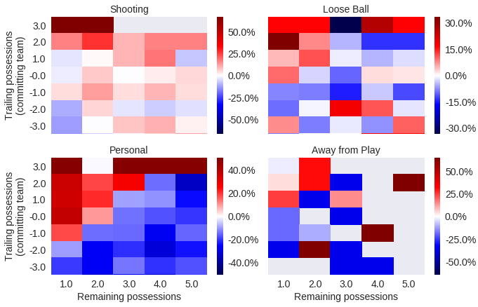
Using Better/More Data
Player Characteristic Data (Height/Wingspan)
Play-by-play + substitution data
Spatial Data
(Foul Maps)
Data
Enhancements
Relying solely on box score stats proved insufficient for prediction
“Close game” data
Includes more specific foul data
(Foul type)
New
Sources
Notes:
KARIM
In our data analysis we relied on player's game box score stats across multiple games and seasons as our basis from which to draw variables. However, it became clear by the end of our analysis that box score data alone was not sufficient enough to accurately predict foul count or fouling out.
As we alluded to in our previous presentation on decision models, we believed that if it was possible incorporating individual player characteristic data, such as heights, and spatial data, such as fouled-shot maps or foul maps could provide more relevant data that would lead to better prediction and model performance that shooting data for this problem.
https://github.com/atlhawksfanatic/L2M?tab=readme-ov-file
I genuinly just found this, but someone created a gituhb repository of "2-minute-reports" of close games the NBA creates, which includes more specific foul data. Even data that split the fouls out by type, such as shooting, offensive, and personal would've helped with better prediction
Show less

Slide 41
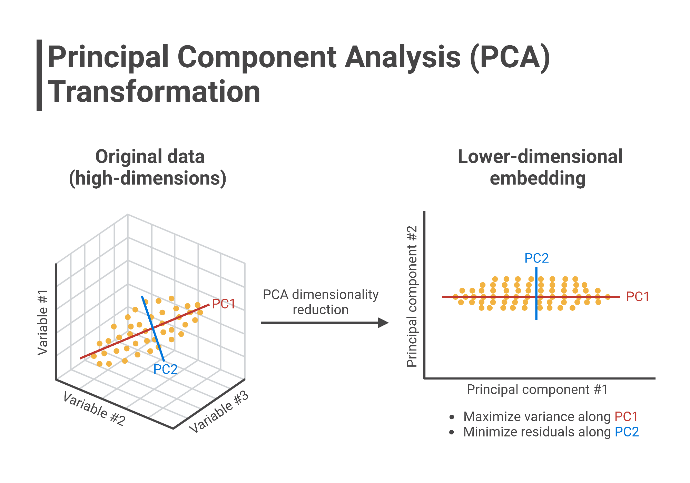
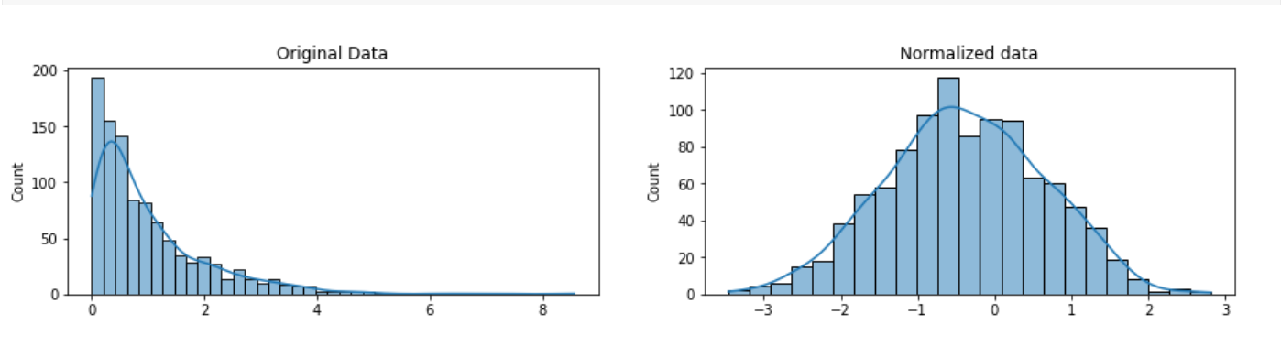
Feature Engineering
Feature Engineering (transforming variables/inputs) could improve model effectiveness, though we believe effectiveness would be limited as the data is not very predictive
Scaling and Standardization
Variable Reduction
Variable Combination (PCA) or Dimension Reduction
Though not feature engineering, data augmentation/resampling techniques like minority undersampling (SMOTE) were used
Notes:
YUJIN
Normalization such as standardization,( log(variables) scalin)
Variable combination (through things like Principal Component Analysis (PCA))
To make up for the fact that the class was imbalance

Slide 42
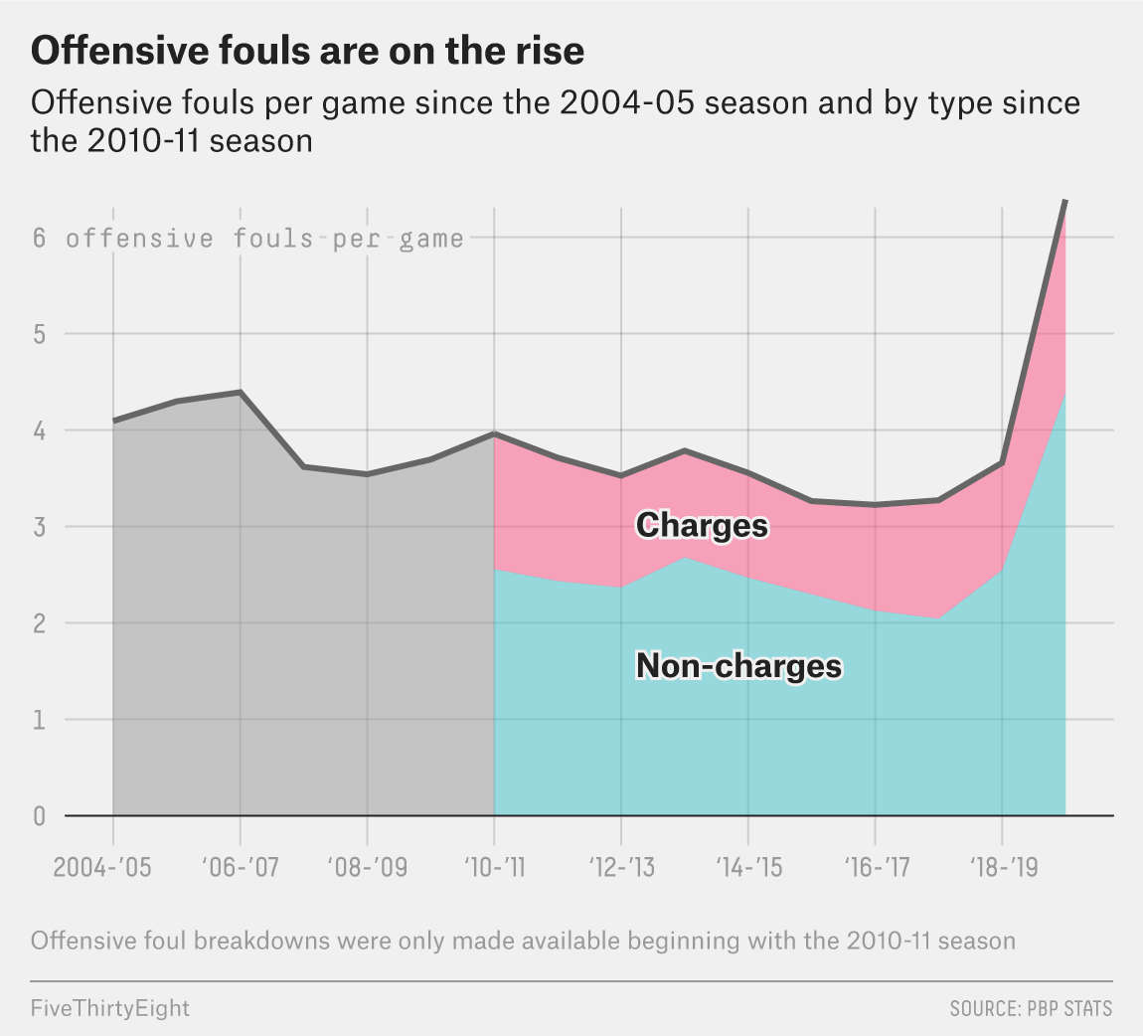
Asking the Right Question
Reevaluating the Problem Statement:
Predicting number of fouls !=
Predicting Impact of fouls
Lack of Context:
Our current model treats all fouls equally
Narrowing the Scope:
Differentiate between offensive and defensive fouls, and non-FT causing fouls
Evaluate foul behavior
(Tactical vs Unintentional)
How does the number of fouls committed by a player affect play-by-play player performance?
Notes:
YUJIN
Our current study focuses on predicting the number of fouls, but we may need to refine our research questions to provide more value.
Specifically, distinguishing between offensive and defensive fouls or analyzing "optimal" foul behavior could be more beneficial for stakeholders.
For example, intentional fouls, defensive shooting fouls, and offensive fouls have different impacts on the game, but our model treats all fouls as equally bad, limiting its practical utility.
A more specific question, like "how do fouls affect play-by-play performance," combined with detailed data, could yield more actionable insights in the future.

Slide 43

Thank You
Questions/Feedback?
Data Science for Sports

Slide 44



GB Modified
01. Recap 1
02. Recap 2
03. Recap 3
Ensure the lesson and rules are remembered.
Ensure the lesson and rules are remembered.
Ensure the lesson and rules are remembered.
Back to Agenda Page
Notes:
Data-driven decision-making in high-stakes environments
Basketball Teams and Coaches: Teams can leverage the spatial tracking data to optimize strategies
Players: Individual athletes benefit by understanding how they perform in specific situations
General Managers and Front Offices: They can use this data to make more informed decisions on trades, draft picks, and contract negotiations.
Analysts and Data Scientists in Sports: This data gives analysts tools to create predictive models for game performance and identify trends over time.
Fans and Sports Media: Advanced metrics derived from the data offer deeper insights into the game, creating more engaging content for fans.

Slide 45

Random Forest Classification
01. Recap 1
02. Recap 2
03. Recap 3
Ensure the lesson and rules are remembered.
Ensure the lesson and rules are remembered.
Ensure the lesson and rules are remembered.
Back to Agenda Page
Notes:
Data-driven decision-making in high-stakes environments
Basketball Teams and Coaches: Teams can leverage the spatial tracking data to optimize strategies
Players: Individual athletes benefit by understanding how they perform in specific situations
General Managers and Front Offices: They can use this data to make more informed decisions on trades, draft picks, and contract negotiations.
Analysts and Data Scientists in Sports: This data gives analysts tools to create predictive models for game performance and identify trends over time.
Fans and Sports Media: Advanced metrics derived from the data offer deeper insights into the game, creating more engaging content for fans.

Slide 46
RF Modified
01. Recap 1
02. Recap 2
03. Recap 3
Ensure the lesson and rules are remembered.
Ensure the lesson and rules are remembered.
Ensure the lesson and rules are remembered.
Back to Agenda Page
Notes:
Data-driven decision-making in high-stakes environments
Basketball Teams and Coaches: Teams can leverage the spatial tracking data to optimize strategies
Players: Individual athletes benefit by understanding how they perform in specific situations
General Managers and Front Offices: They can use this data to make more informed decisions on trades, draft picks, and contract negotiations.
Analysts and Data Scientists in Sports: This data gives analysts tools to create predictive models for game performance and identify trends over time.
Fans and Sports Media: Advanced metrics derived from the data offer deeper insights into the game, creating more engaging content for fans.

Slide 47



Methods/Metrics Used
Field Goal % (FG%), expected Field Goal % (eFG%) | Field Goal% or expected Field Goal % shows the % of made baskets over field goal attempts, or the expected standard per team/player
Offensive Rebounding % (OR%/OREB%) | Offensive Rebounding % shows the amount of offensive rebounds (second chance opportunities) from the total number of missed field goal attempts
Rebound Distance, Shot Distance (ft) | Average distance from the hoop a rebound lands or a shot is taken
Points Conceded | Average points conceded depending on the play (live ball, fast break/transition, etc.)
Expected Points Gain (EV) | Shows the expected gain (in points), by crashing based on the eFG, OR%, and average points conceded from fast break/transition plays
Visualizations: Rebound Map, Simple Line/Scatter charts (Regression)

Slide 48
Findings
Preliminary scatterplot shows teams tend to play a more conservative style
Knicks (1st in OR%) lead the league in second chance points, but are one of the worst in terms of opponent fast break points
Raptors (30th in OR%) are one of the worst teams in second chance points, but one of the best in opponent fast break points
Question: How indicative is this of on-court performance…
Notes:
Raptors don’t pressure the glass as much as teams like the NYK, so they are better in terms of opponent fast break points
Data-driven decision-making in high-stakes environments
Basketball Teams and Coaches: Teams can leverage the spatial tracking data to optimize strategies
Players: Individual athletes benefit by understanding how they perform in specific situations
General Managers and Front Offices: They can use this data to make more informed decisions on trades, draft picks, and contract negotiations.
Analysts and Data Scientists in Sports: This data gives analysts tools to create predictive models for game performance and identify trends over time.
Fans and Sports Media: Advanced metrics derived from the data offer deeper insights into the game, creating more engaging content for fans.

Slide 49

Findings
Despite NYK and SAK being in the “Fantastic” region, they are not performing well in standings
Of the 12 teams in the “net-positive” region, 6 have winning records and 6 have losing records
However, we can see a trend that shows that as second chance points increase, opponent fast break points increase as well.
Is crashing worth the trade-off?
External factors:
Turnovers
Game pressure
Score of the game
Notes:
Raptors don’t pressure the glass as much as teams like the NYK, so they are better in terms of opponent fast break points
Data-driven decision-making in high-stakes environments
Basketball Teams and Coaches: Teams can leverage the spatial tracking data to optimize strategies
Players: Individual athletes benefit by understanding how they perform in specific situations
General Managers and Front Offices: They can use this data to make more informed decisions on trades, draft picks, and contract negotiations.
Analysts and Data Scientists in Sports: This data gives analysts tools to create predictive models for game performance and identify trends over time.
Fans and Sports Media: Advanced metrics derived from the data offer deeper insights into the game, creating more engaging content for fans.

Slide 50
Findings
Dunks (0ft shot distance) become rebounds 5-6ft from the basket
Other close range shots also have relatively high rebound distance
This is because defenders are typically contesting these short range shots and so they fall to secondary defenders
After this, as shots push out into midrange, rebounding distance trends downwards
As shots push further into the 3 point rage and beyond, rebound distance increases again
Rebound distance depends on shot distance, shot angle, and player spacing during the shot.
We can see that crashing is more of a question for three point shooting than midrange shots.
Notes:
Raptors don’t pressure the glass as much as teams like the NYK, so they are better in terms of opponent fast break points
Data-driven decision-making in high-stakes environments
Basketball Teams and Coaches: Teams can leverage the spatial tracking data to optimize strategies
Players: Individual athletes benefit by understanding how they perform in specific situations
General Managers and Front Offices: They can use this data to make more informed decisions on trades, draft picks, and contract negotiations.
Analysts and Data Scientists in Sports: This data gives analysts tools to create predictive models for game performance and identify trends over time.
Fans and Sports Media: Advanced metrics derived from the data offer deeper insights into the game, creating more engaging content for fans.

Slide 51

Key Takeaways
Offensive rebounding is generally decreasing over time
Teams are prioritizing faster transition play and sending fewer players to crash the board
Tactical crashing is ideal
Further analysis/research must be done to better determine how efficient Offensive Crashing is
Notes:
Data-driven decision-making in high-stakes environments
Basketball Teams and Coaches: Teams can leverage the spatial tracking data to optimize strategies
Players: Individual athletes benefit by understanding how they perform in specific situations
General Managers and Front Offices: They can use this data to make more informed decisions on trades, draft picks, and contract negotiations.
Analysts and Data Scientists in Sports: This data gives analysts tools to create predictive models for game performance and identify trends over time.
Fans and Sports Media: Advanced metrics derived from the data offer deeper insights into the game, creating more engaging content for fans.

Slide 52

Future Research
An NBA team could create a Random Forest Model to research if/when to use Offensive Crashing
Analyzes interactions between variables
Can intake continuous, ordinal and discrete variables
Easily interpretable output
Output is a rules-based flow chart that a team can use before/during play to determine if/when to crash

Slide 53

Model Fit
A Random Forest model can reduce both bias and variance compared to one Decision Tree, allowing a team to create unique models for each NBA opponent team
Can be trained to prioritize variables such as second-chance points gained or points conceded to fast breaks
Models can be pruned to prevent overfitting
If reinforcement learning is the priority, a Neural Network may be the model of choice.
Further research can analyze second-chance opportunity efficiencies.

Slide 54


BASKETBALL DRILLS
Drag and drop your photo or video! Click the sample photo or video and delete. Select yours from the uploads tab, drag, and then drop inside the frame!
Dribbling
Passing
Shooting
Demonstrate the drill and explain its purpose in the sport.
Demonstrate the drill and explain its purpose in the sport.
Demonstrate the drill and explain its purpose in the sport.
Back to Agenda Page

Slide 55





GAMEPLAY
TEAM MATCHING
TEAM MATCHING
TEAM MATCHING
Time for a friendly basketball game!
Time for a friendly basketball game!
Time for a friendly basketball game!
Back to Agenda Page

Slide 56
Stakeholder Conclusions
01. Recap 1
02. Recap 2
03. Recap 3
Ensure the lesson and rules are remembered.
Ensure the lesson and rules are remembered.
Ensure the lesson and rules are remembered.
Back to Agenda Page
Notes:
Data-driven decision-making in high-stakes environments
Basketball Teams and Coaches: Teams can leverage the spatial tracking data to optimize strategies
Players: Individual athletes benefit by understanding how they perform in specific situations
General Managers and Front Offices: They can use this data to make more informed decisions on trades, draft picks, and contract negotiations.
Analysts and Data Scientists in Sports: This data gives analysts tools to create predictive models for game performance and identify trends over time.
Fans and Sports Media: Advanced metrics derived from the data offer deeper insights into the game, creating more engaging content for fans.

Slide 57
WRAPPING UP & COOLING DOWN
01. Recap 1
02. Recap 2
03. Recap 3
Ensure the lesson and rules are remembered.
Ensure the lesson and rules are remembered.
Ensure the lesson and rules are remembered.
Back to Agenda Page

Slide 58
Data Used
Field Goal % (FG%), expected Field Goal % (eFG%) | Field Goal% or expected Field Goal % shows the % of made baskets over field goalattempts, or the expected standard per team/player
Offensive Rebounding % (OR%/OREB%) | Offensive Rebounding % shows the amount of offensive rebounds (second chance opportunities) from the total number of missed field goal attempts
Rebound Distance, Shot Distance (ft) | Average distance from the hoop a rebound lands or a shot is taken
Points Conceded | Average points conceded depending on the play (live ball, fast break/transition, etc.)
Expected Points Gain (EV) | Shows the expected gain (in points), by crashing based on the eFG, OR%, and average points conceded from fast break/transition plays
Visualizations: Rebound Map, Simple Line/Scatter charts (Regression)

Slide 59
FG% and eFG% | C for confetti
OR% | M for mic drop
Rebound Distance (ft) vs Shot Distance (ft) | Q for quiet
U for unveil | Any number from 0-9 for a timer
Data Used
Find the magic and fun in presenting with Canva Presentations. Press the following keys while on Present mode!
Delete or hide this page before presenting.

